Slide 1
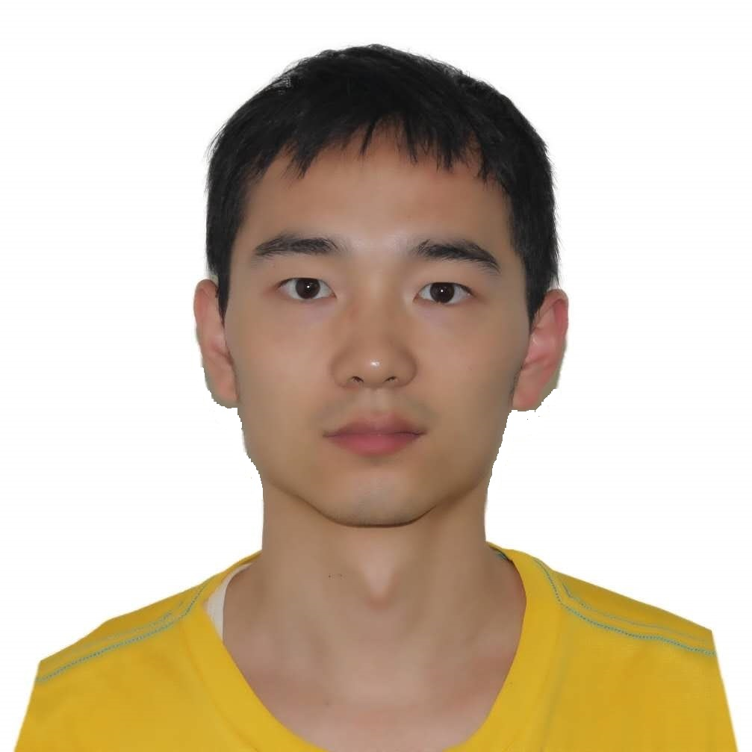


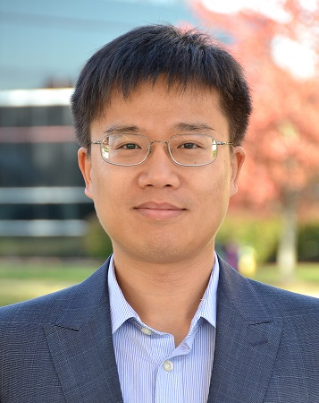

New Frontiers of Knowledge Graph Reasoning:
Recent Advances and Future Trends
Lihui Liu
Zihao Wang
Jiaxin Bai
Yangqiu Song
Hanghang Tong
lihuil2@illinois.edu zwanggc@cse.ust.hk jbai@connect.ust.hk yqsong@cse.ust.hk htong@illinois.edu

Slide 2
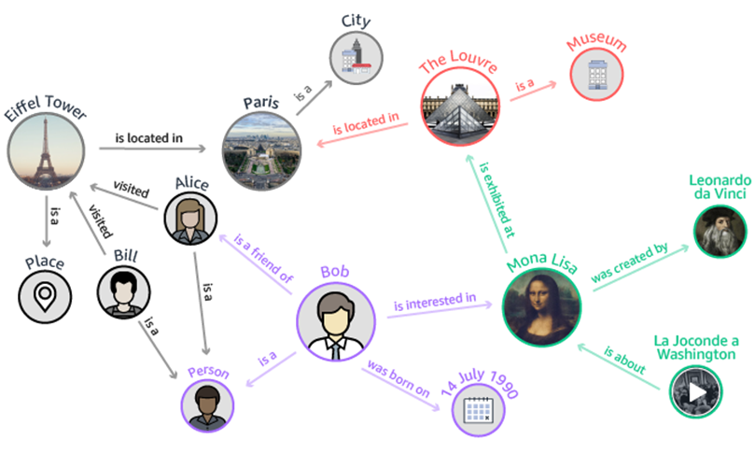
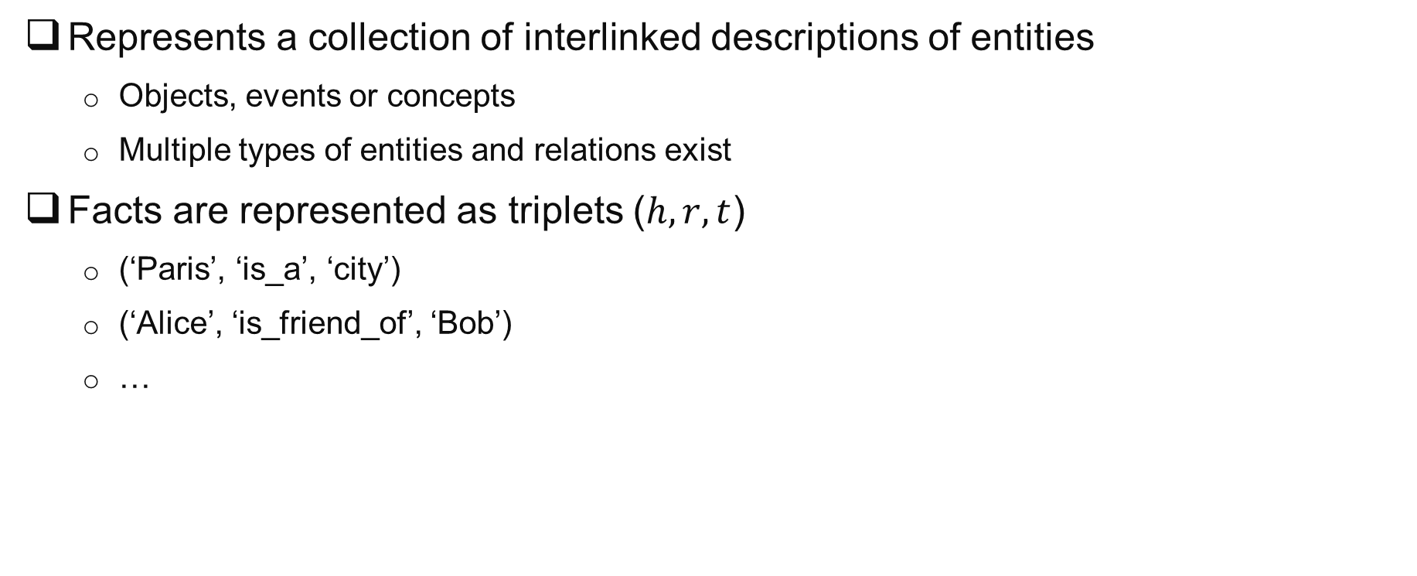
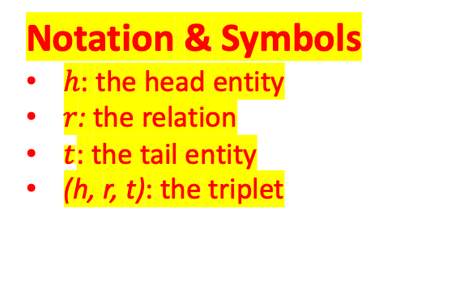
Knowledge Graph
Represents a collection of interlinked descriptions of entities
Objects, events or concepts
Multiple types of entities and relations exist
Facts are represented as triplets ($h, r, t$)
(‘Paris’, ‘is_a’, ‘city’)
(‘Alice’, ‘is_friend_of’, ‘Bob’)
…
Notation & Symbols
ℎ: the head entity
𝑟: the relation
$t$: the tail entity
(h, r, t): the triplet
Notes:
Knowledge graph is a graph structure which represents the relations between different real world entities. These entities can be objects, events or concepts.
Knowledge graph usually contains multiple types of entities and relations, for example, the entity can be a person, like Alice, Bob, Bill. Or a place, like Paris, or Eifel tower.
The relation can be “is a friend of”, “is located in” “visited” and so on.
Knowledge graph can be seen as a collection of real-world facts, where each fact can be represented as a triplet in the knowledge graph. For example, Paris is a city. And Alex is a friend of Bob. Are two facts in the knowledge graph.

Slide 3
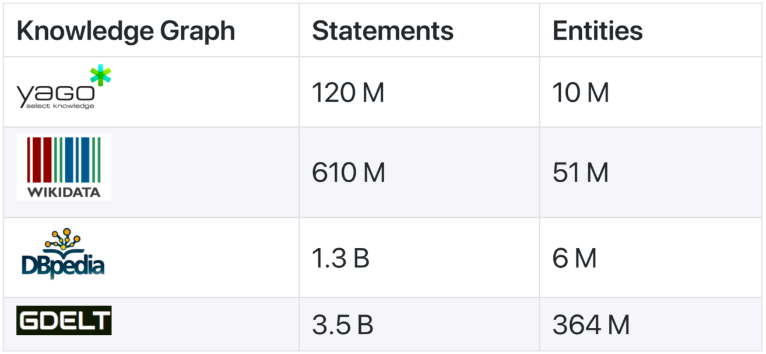
Abundance of Knowledge Graphs
[1] https://yago-knowledge.org/
[2] https://www.wikidata.org/wiki/Wikidata:Main_Page
[3] https://www.dbpedia.org/resources/knowledge-graphs/
[4] https://blog.gdeltproject.org/gdelt-global-knowledge-graph/
Notes:
There is a wealth of knowledge graphs available online, they can be domain specific or general purpose. Some commonly used knowledge graphs including yago, wikidata, Dppedia, and so on.
These knowledge graphs are usually very large, containing millions or billions facts, and millions of entities.
For example, the GDELT Global Knowledge Graph contains about 3.5 billions of facts and more than 300 millions of entities.

Slide 4
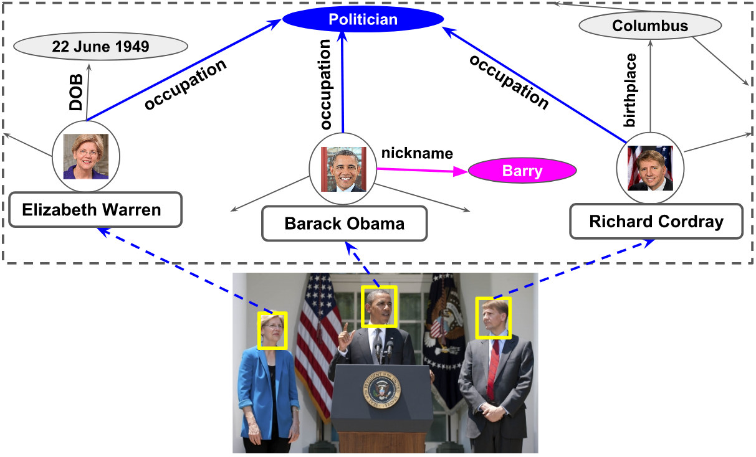
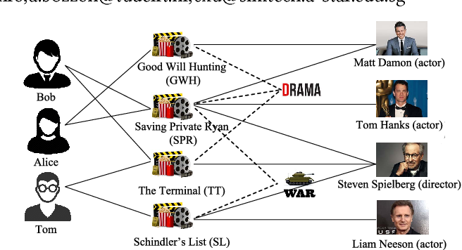
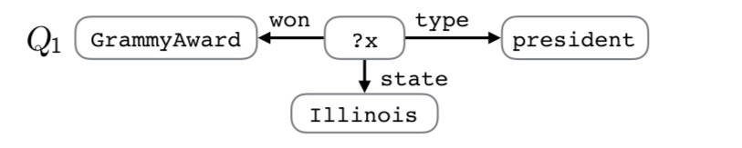
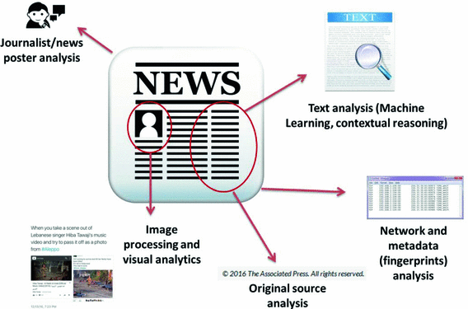
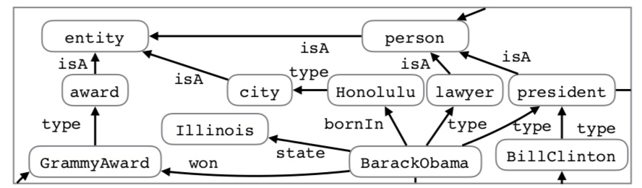
Knowledge Graph Applications
Computer Vision [1]
Recommendation [2]
Question Answering [3]
Fact Checking [4]
…
[1] Y. Fang, K. Kuan, J. Lin, C. Tan, and V. Chandrasekhar. 2017. Object Detection Meets Knowledge Graphs(IJCAI 17).
[2] F. Zhang, J. Yuan, D. Lian, X. Xie, and W. Ma. 2016. Collaborative Knowledge Base Embedding for Recommender Systems(KDD 16).
[3] S. Hu, L. Zou, J. X. Yu, H. Wang, and D. Zhao. 2018. Answering Natural Language Questions by Subgraph Matching over Knowledge Graphs (TKDE 18).
[4] P. Shiralkar, A. F Flammini, F. Menczer, and G. Luca. 2017. Finding Streams in Knowledge Graphs to Support Fact Checking (ICDM 17).
Notes:
Knowledge Graph has many applications. For example, in computer vision, knowledge graphs can be used to identify the people in the image. In recommender system, knowledge graph can be used to find similar items. In question answering, the natural language question can be transformed into a query graph. Then we can use the subgraph matching method to research the knowledge graph and answer the question. And in fact-checking, each claim can be expressed as a triplet and the knowledge graph can be used to check whether the claim is true or false.

Slide 5
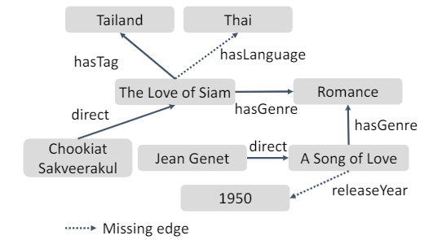
What is Knowledge Graph Reasoning?
Goal: Infer or discover new knowledge according to existing information in knowledge graphs in response to a query [1]
Benefit: Enable models to learn from and reason with structured knowledge graph data
Missing
New knowledge
Infer
[1] X. Chen, S. Jia, and Y. Xiang. 2020. A review: Knowledge reasoning over knowledge graph (Expert Systems with Applications 20).
Notes:
The goal of knowledge graph reasoning is to Infer or discover new knowledge according to existing information in knowledge graphs.
For example, in the incomplete knowldeg graph on the left hand of this slides, the link between entities “the love of siam” and “Thai” is mussing, but we can infer “the love of siam” has language Thai, according to the triplet (The love siam, hasTag, Tailand).
Knowledge graph reasoning is a fundamental aspect of artificial intelligence and machine learning, as it enables models to learn from structured graph data.

Slide 6
Knowledge Graph Reasoning Categorization
Class: Deductive reasoning
Apply known rules to derive knowledge
(A, hasSon, B)&(B, hasSon, C)
Infer: (A, isGrandFather, C)
Class: Abductive reasoning
Choose the best explanation that explains an observation
(A, liveWith, B)
Explanation: (A, hasSpouse, B)
Class: Inductive reasoning
Use patterns in observations to derive knowledge
Give many examples of
(A, hasSon, B)&(B, hasSon, C)
(A, isGrandFather, C)
Derive:
hasSon & hasSon means isGrandFather
[1] AIB 22 – Knowledge Graphs and Machine Learning. https://researchschool.w.uib.no/

Slide 7
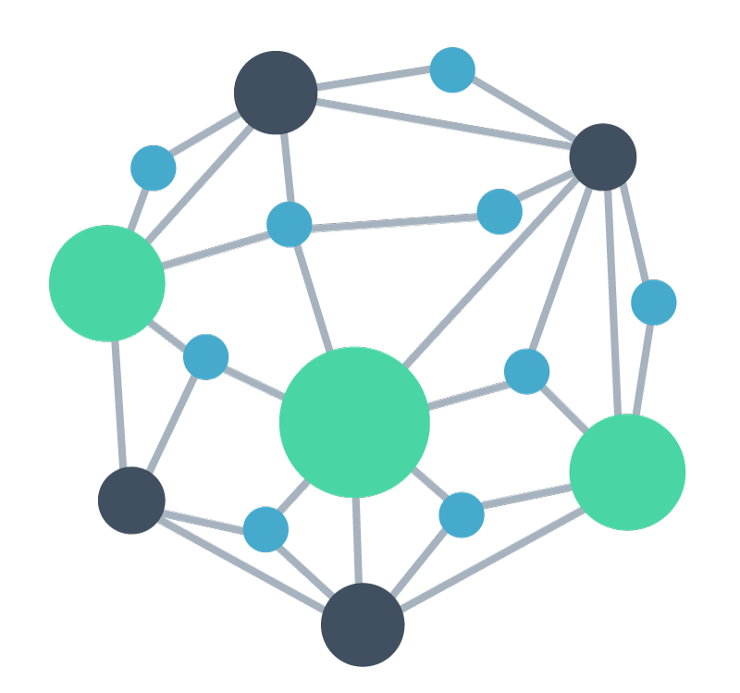
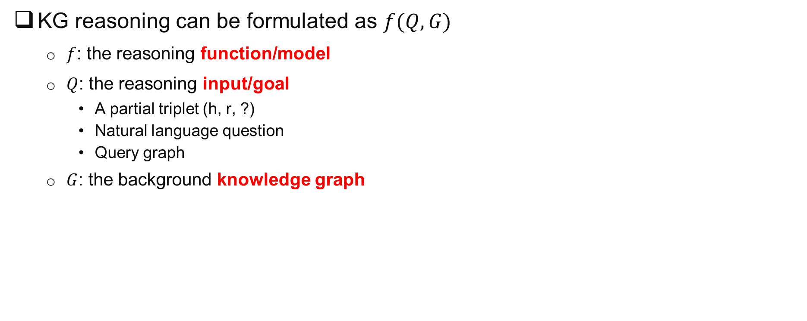
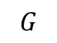
Knowledge Graph Reasoning Formulation
KG reasoning can be formulated as $f(Q,G)$
$f$: the reasoning function/model
$Q$: the reasoning input/goal
A partial triplet (h, r, ?)
Natural language question
Query graph
$G$: the background knowledge graph
Input 𝑄
Reasoning Model 𝑓()
Output
$$G$$
Notes:
Generally, the knowledge graph reasoning contains three components which are the reasoning function f, the reasoning input Q and the background knowledge graph G. Each component brings some unique challenges associated with it.

Slide 8
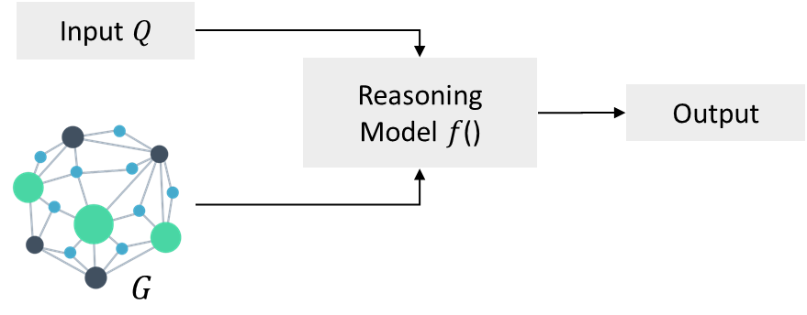
Overall Challenge #1: Background Knowledge Graph
Size: KGs are large
For example, DBpedia contains 4.6 million entities
Reasoning on large knowledge graph is time consuming
Quality: KGs are noisy and incomplete
For example, half of entities in DBpedia contain less than 5 relationships [1]
Reasoning on incomplete knowledge graphs can be difficult
Dynamics: Almost every knowledge graph evolves over time [2]
Present an additional challenge
[1] Y. Fang, K. Kuan, J. Lin, C. Tan, and V. Chandrasekhar. 2017. Object Detection Meets Knowledge Graphs(IJCAI 17).
[2] Y. Yan, L. Liu, Y. Ban, Bao. Jing, and H. Tong. 2021. Dynamic Knowledge Graph Alignment(AAAI 21).
Notes:
The first group of challenges are from the background knowledge graph. Although knowledge graphs have been extensively used in various applications, real-world knowledge graphs tend to be vast and incomplete. For example, DBpedia contains 4.6 million entities.
Reasoning on large knowledge graph is time consuming.
Besides, half of entities in DBpedia contain less than 5 relationships which means it has numerous missing or incomplete triples.
As a result, reasoning on incomplete knowledge graphs can be difficult.
Last but not the least, real-world knowledge graphs often evolve over time, which presents an additional challenge.

Slide 9
Overall Challenge #2: The Reasoning Model
Comprehensiveness: Relations in KG have different properties [1]
Symmetry, antisymmetry, composition
How to support these properties
Efficiency: Knowledge graphs are large [2]
How to reason efficiently
Generalizability: Generalization ability of the model [3]
Handle new, unseen data effectively
[1] B. Antoine, U. Nicolas, G. Alberto, W Jason, and Y. Oksana. 2013. Translating Embeddings for Modeling Multi-relational Data (NIPS 13).
[2] S. Hu, L. Zou, J. X. Yu, H. Wang, and D. Zhao. 2018. Answering Natural Language Questions by Subgraph Matching over Knowledge Graphs (TKDE 18).
[3] M. Chen1, W. Zhang1, W. Zhang , Q. Chen , H. Chen. 2019. Meta Relational Learning for Few-Shot Link Prediction in Knowledge Graphs (EMNLP 19).
Notes:
The second group of challenges are from the reasoning model.
due to the varied properties of relations in knowledge graphs, designing an all-round KG reasoning model that fits all these properties can be challenging.
Furthermore, the volume of knowledge graphs presents significant computational challenge for efficient reasoning.
Last but not the least, the generalization ability of the reasoning model is critical for handling new, unseen data effectively.

Slide 10
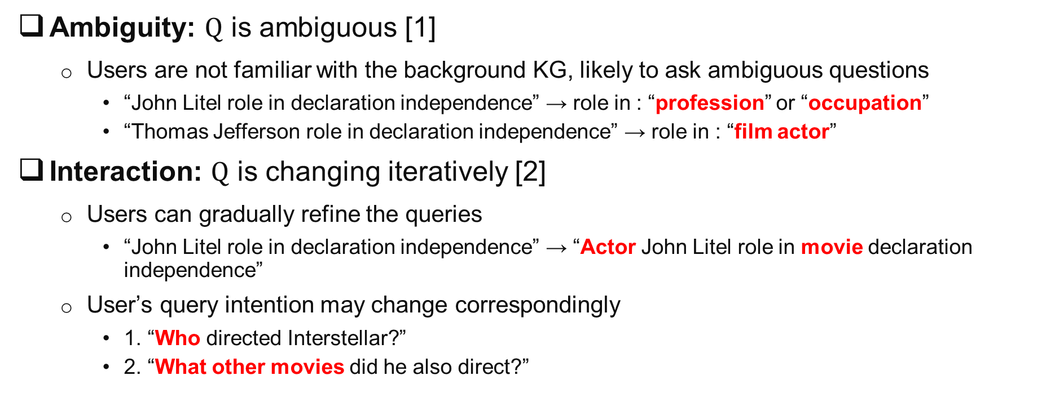
Overall Challenge #3: Reasoning Input
Ambiguity: $Q$ is ambiguous [1]
Users are not familiar with the background KG, likely to ask ambiguous questions
“John Litel role in declaration independence” → role in : “profession” or “occupation”
“Thomas Jefferson role in declaration independence” → role in : “film actor”
Interaction: $Q$ is changing iteratively [2]
Users can gradually refine the queries
“John Litel role in declaration independence” → “Actor John Litel role in movie declaration independence”
User’s query intention may change correspondingly
1. “Who directed Interstellar?”
2. “What other movies did he also direct?”
[1] L. Lihui, C. Yuzhong, D. Mahashweta, Y. Hao and T. Hanghang. 2023. Knowledge Graph Question Answering with Ambiguous Query (WWW 2023).
[2] M. Kaiser, R. Saha Roy, and G. Weikum. 2021. Reinforcement Learning from Reformulations in Conversational Question Answering over Knowledge Graphs (SIGIR 21).
Notes:
The third group of challenges are from the reasoning input.
In some KG reasoning applications, users may be unfamiliar with the background knowledge graph, leading to the possibility of asking ambiguous questions.
Moreover, some applications require iterative reasoning, where users ask several related questions in sequence, further increasing the complexity of the task.

Slide 11

Roadmap
Part I: Knowledge Graph Reasoning: Basic Concepts and Techniques
Part II: Recent Advance #1: Neural Reasoning for Natural Language Queries
Part III: Recent Advance #2: Neural Reasoning for Logical Queries
Part IV: Recent Advance #3: Neural Reasoning Beyond Entities and Relations
Part V: Recent Advance #4: LLM+KGR
Part VI: Open Challenges and Future Directions
Notes:
Today’s tutorial contains 6 parts.
At the beginning, I would like to give some background regarding the knowledge graph reasoning as well as the unique challenges behind this problem setting.
In part 1, we will introduce the details of general knowledge graph reasoning. and in part 2, we will introduce query specific knowledge graph reasoning. And finally, we will discuss the future trends for knowledge graph reasoning.

Slide 12
Overview of Part I
Basic Concepts and Techniques
Knowledge Graph Embedding
Rule Based Knowledge Graph Reasoning
Path Based Knowledge Graph Reasoning
Inductive Rule Mining
TransE
Hard Rule Based Reasoning
Path Ranking
Chain-like Rules
Subgraph Rules
Notes:
In this part, I will introduce the General Knowledge Graph Reasoning from 4 categories, Knowledge Graph Embedding, xxxxx, path xxx, and xxx.
Now, let’s see the first category knowledge graph embedding.

Slide 13
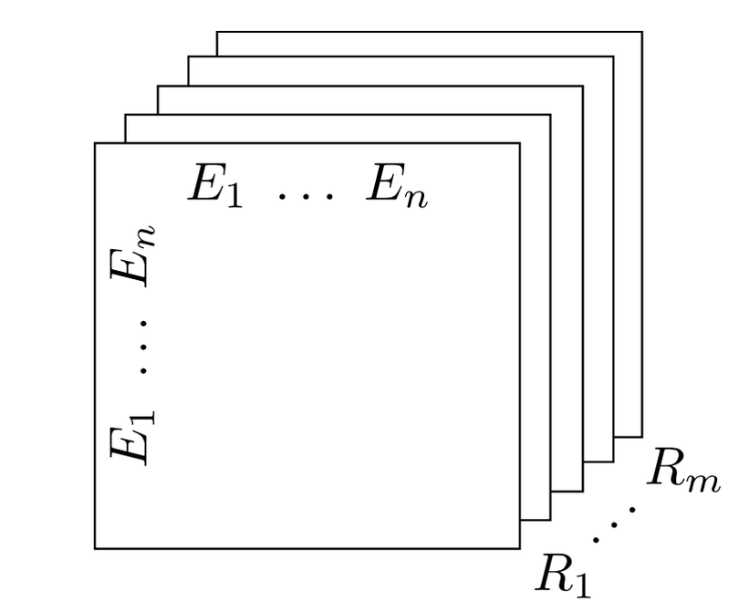
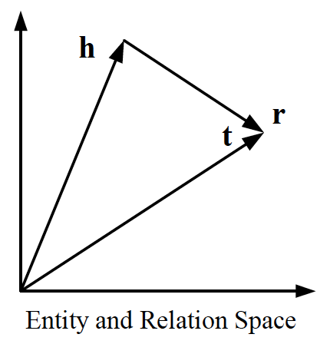
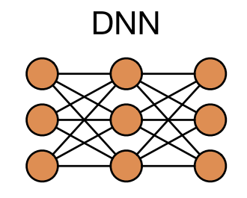
Reasoning in Continuous Space
Reasoning based on low-dimensional vector representations
Knowledge graph embedding methods
Project each entity and relation into a continuous vector space
Tensor decomposition model [1], geometric model [2], deep learning model [3]
[1] T. Trouillon, J. Welbl, S. Riedel, E. Gaussier, and G Bouchard. 2016. Complex Embeddings for Simple Link Prediction (ICML 16).
[2] A. Bordes, N. Usunier, and A. Garcia-Duran. 2013. Translating Embeddings for Modeling Multi-relational Data (NeurIPS 13).
[3] T. Dettmers, P. Minervini, P. Stenetorp, and S. Riedel. 2018. Convolutional 2D Knowledge Graph Embeddings (AAAI 18).
Notes:
One of most common and most fundamental reasoning is reasoning in continuous space.
Most knowledge graph embedding methods belong to this category.
As its name suggests these methods will project each entity and relation into continuous vector space.
Many methods exist, and some commonly used model include Tensor decomposition model, geometric model, deep learning model.

Slide 14
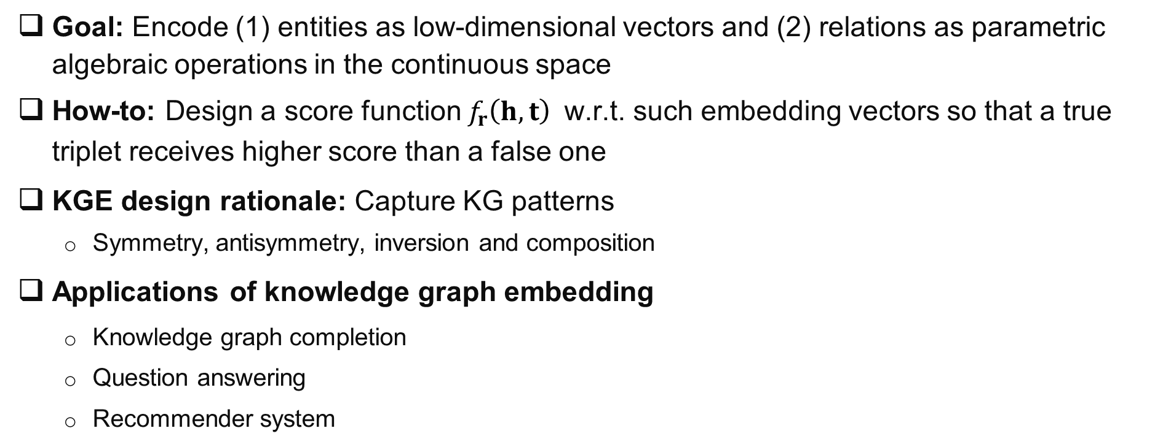
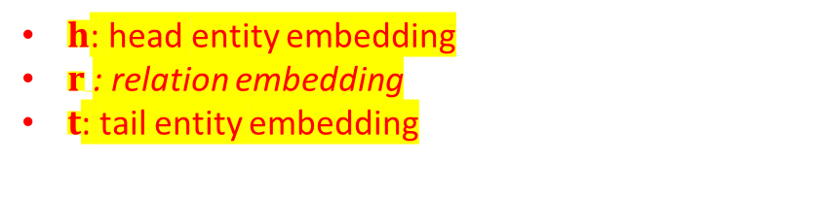
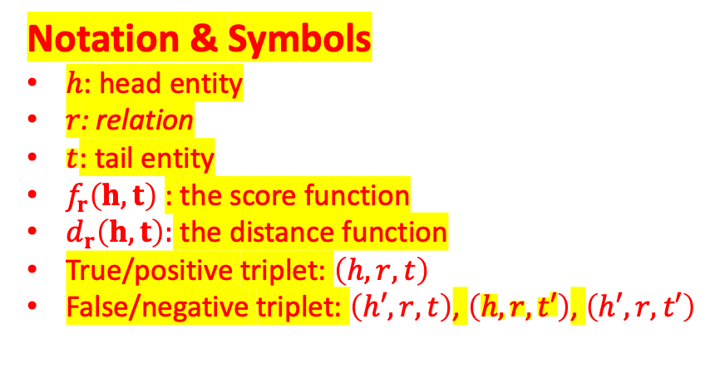
Knowledge Graph Embedding
Goal: Encode (1) entities as low-dimensional vectors and (2) relations as parametric algebraic operations in the continuous space
How-to: Design a score function ${f_{r}\left(h,t\right)}_{ }$ w.r.t. such embedding vectors so that a true triplet receives higher score than a false one
KGE design rationale: Capture KG patterns
Symmetry, antisymmetry, inversion and composition
Applications of knowledge graph embedding
Knowledge graph completion
Question answering
Recommender system
Notation & Symbols
ℎ: head entity
𝑟: relation
$t$: tail entity
$f_{r}\left(h,t\right)$: the score function
$d_{r}\left(h,t\right):$ the distance function
True/positive triplet: $\left(h,r, t\right)$
False/negative triplet: $\left(h′,r, t\right)$, $\left(h,r, t′\right)$, $\left(h′,r, t′\right)$
$h$: head entity embedding
$r$: relation embedding
$t$: tail entity embedding
[1] T. Trouillon, J. Welbl, S. Riedel, E. Gaussier, and G Bouchard. 2016. Complex Embeddings for Simple Link Prediction (ICML 16).
[2] A. Bordes, N. Usunier, and A. Garcia-Duran. 2013. Translating Embeddings for Modeling Multi-relational Data (NeurIPS 13).
[3] T. Dettmers, P. Minervini, P. Stenetorp, and S. Riedel. 2018. Convolutional 2D Knowledge Graph Embeddings (AAAI 18).
Notes:
Knowledge graph embedding usually encode entities as low-dimensional vectors and Encode relations as parametric algebraic operations in the continuous space.
The basic idea is to design a score function f which takes the triplet embedding as input , so that a true triplet receives higher score than a false one.
Apparently, the choice of the score function is the key of kg embedding. Generally speaking, an ideal kg embedding model should be able to capture different relation patterns in the embedding space, such as Symmetry, antisymmetry, inversion and composition.
Before we introduce these relation patterns/properties, let’s briefly talk about the application of kg embedding. There are a lot of applications which utilize knowledge graph embedding. One of the most common application is knowledge graph completion. For example, given a head entity and a tail entity, the missing relation is the one which maximizes the score function value. Likewise, given a head entity and a relation, the missing tail entity is the one which, again, maximizes the score function value.
Beyond kg completion, other applications include question answering, recommender system and so on.

Slide 15
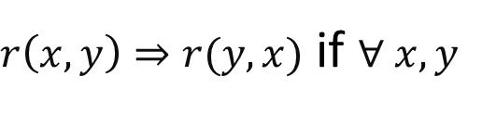
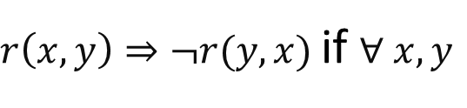
Preliminary: Symmetric/Antisymmetric Relations
Symmetric/Antisymmetric Relations
Symmetric: e.g., Marriage
Antisymmetric: e.g., hasChild
Formally:
r is Symmetric:
$r\left(x,y\right)⇒r(y,x)$ if $∀ x, y$
r is Antisymmetric:
$r\left(x,y\right)⇒¬r(y,x)$ if $∀ x, y$
[1] T. Trouillon, J. Welbl, S. Riedel, E. Gaussier, and G Bouchard. 2016. Complex Embeddings for Simple Link Prediction (ICML 16).
[2] A. Bordes, N. Usunier, and A. Garcia-Duran. 2013. Translating Embeddings for Modeling Multi-relational Data (NeurIPS 13).
[3] T. Dettmers, P. Minervini, P. Stenetorp, and S. Riedel. 2018. Convolutional 2D Knowledge Graph Embeddings (AAAI 18).
Notes:
There are different relation properties in the knowledge graph.
Symmetry and antisymmetry are probably two most common relation patterns/properties.
Their formal definitions are listed here at the bottom of this slides.
An example of symmetric relation is marriage, if x gets married with y, the same relation (marriage) automatically holds in the opposite direction, i.e., y also gets married with x.
An example of antisymmetric relation is hasChild, which means if x hasChild y, the same relation cannot be held in the opposite direction, i.e., y could not have child x.

Slide 16
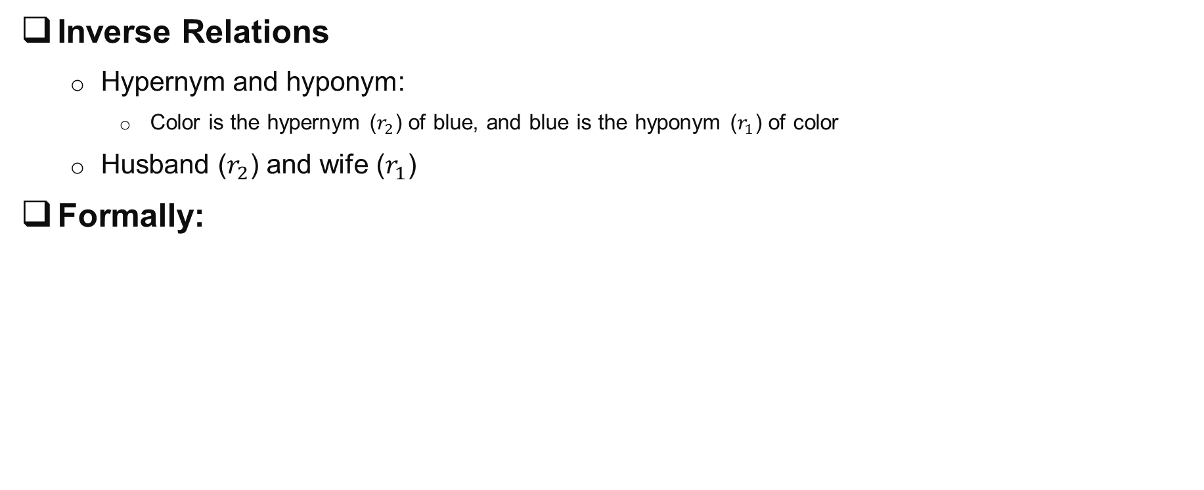
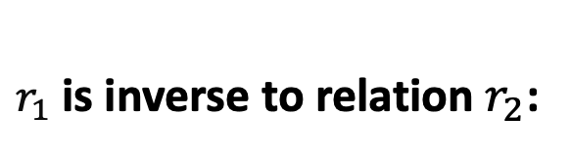
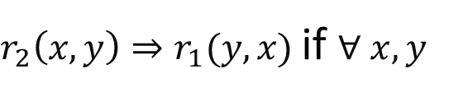
Preliminary: Inverse Relations
Inverse Relations
Hypernym and hyponym:
Color is the hypernym ($r_{2}$) of blue, and blue is the hyponym ($r_{1}$) of color
Husband ($r_{2}$) and wife ($r_{1}$)
Formally:
$r_{1}$ is inverse to relation $r_{2}$:
$r_{2}\left(x,y\right)⇒r_{1}(y,x)$ if $∀ x, y$
[1] T. Trouillon, J. Welbl, S. Riedel, E. Gaussier, and G Bouchard. 2016. Complex Embeddings for Simple Link Prediction (ICML 16).
[2] A. Bordes, N. Usunier, and A. Garcia-Duran. 2013. Translating Embeddings for Modeling Multi-relational Data (NeurIPS 13).
[3] T. Dettmers, P. Minervini, P. Stenetorp, and S. Riedel. 2018. Convolutional 2D Knowledge Graph Embeddings (AAAI 18).
Notes:
Some relations are inversible, for example, Hypernym and hyponym, Husband and wife (in heterosexual marriage).
If one relation (r2) holds for head entity x and tail entity y; the other relation (r1) must hold for head entity y and tail entity x – do not confuse inverse relation with anti-symmetric relation
In heterosexual marriage, if x is the husband (relation r2) of y, then y must be the wife (relation r1) of x.
Color is the hypernym (r2) of blue, and blue is the hyponym of color

Slide 17
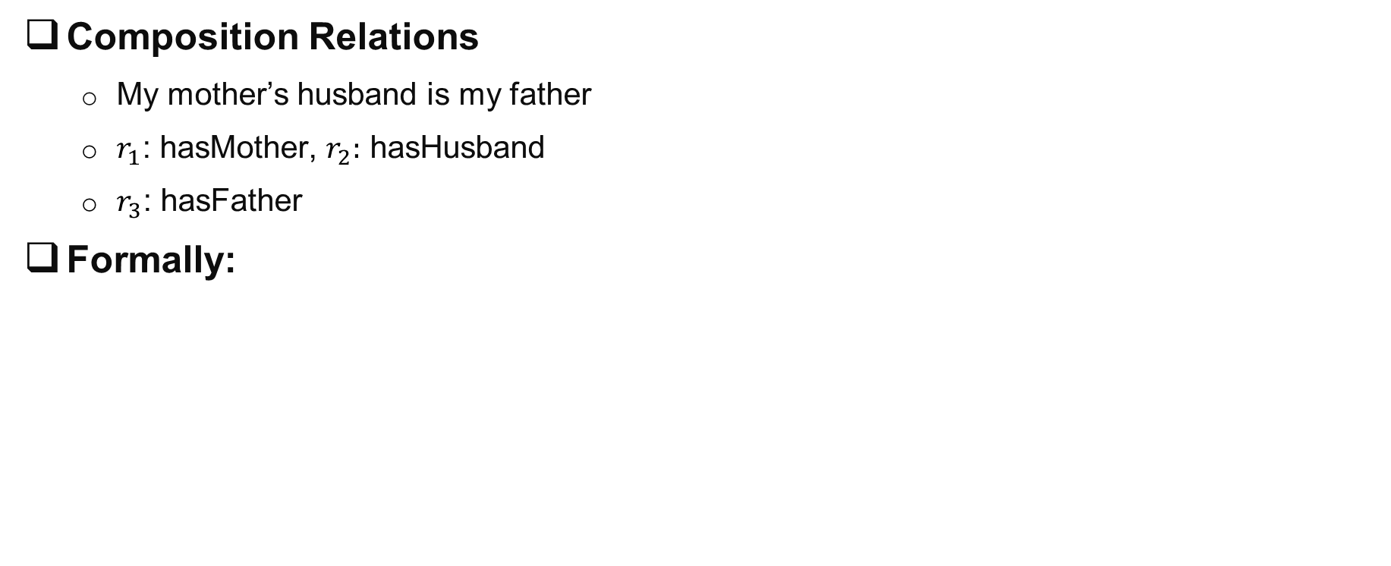
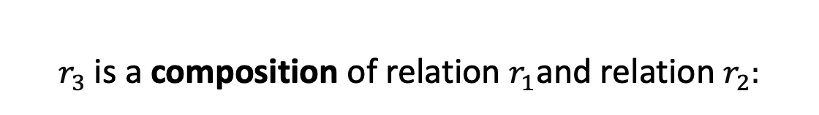
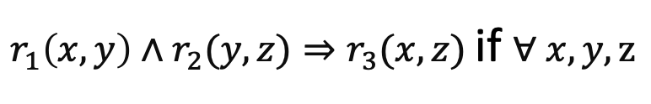
Preliminary: Composition Relations
Composition Relations
My mother’s husband is my father
$r_{1}$: hasMother, $r_{2}:$ hasHusband
$r_{3}$: hasFather
Formally:
$r_{3}$ is a composition of relation $r_{1}$and relation $r_{2}$:
$r_{1}\left(x,y\right)∧r_{2}(y,z)⇒r_{3}(x,z)$ if $∀ x, y, z$
[1] T. Trouillon, J. Welbl, S. Riedel, E. Gaussier, and G Bouchard. 2016. Complex Embeddings for Simple Link Prediction (ICML 16).
[2] A. Bordes, N. Usunier, and A. Garcia-Duran. 2013. Translating Embeddings for Modeling Multi-relational Data (NeurIPS 13).
[3] T. Dettmers, P. Minervini, P. Stenetorp, and S. Riedel. 2018. Convolutional 2D Knowledge Graph Embeddings (AAAI 18).
Notes:
Composition relation involves three relations, r1, r2 and r3. roughly speaking, it is about the propogation of the relations. More specific,
If both r1 and r2 hold, and the tail entity of r1 is the head entity of r2, then, the third relation r3 must hold, with the head entity of r1 as its head entity and the tail entity of r2 as its tail entity.
An example of composition relation is My mother’s husband is my father.

Slide 18
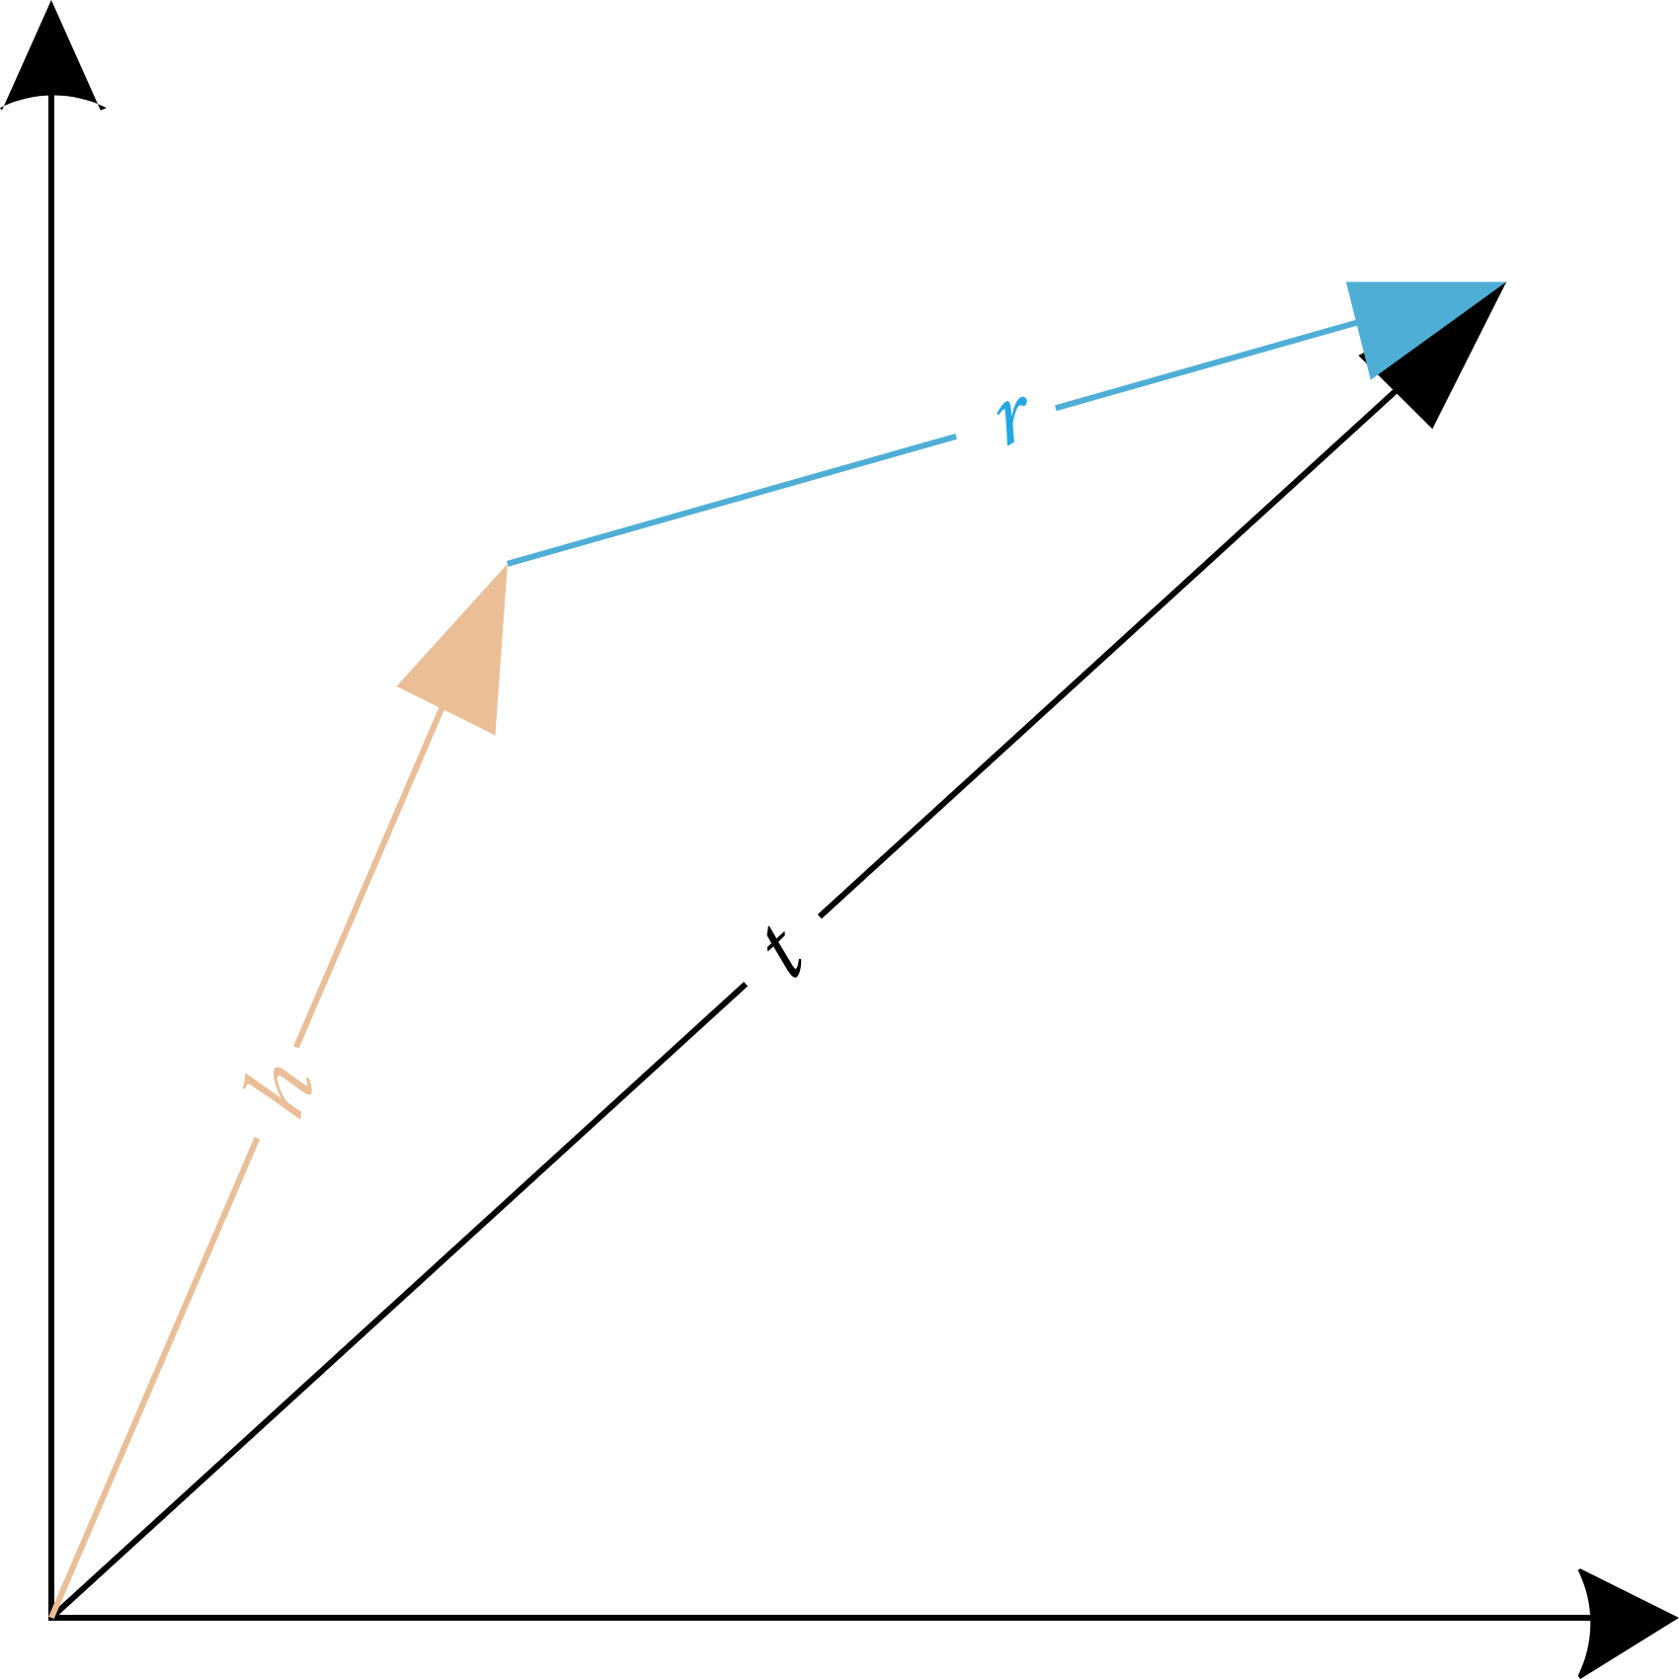
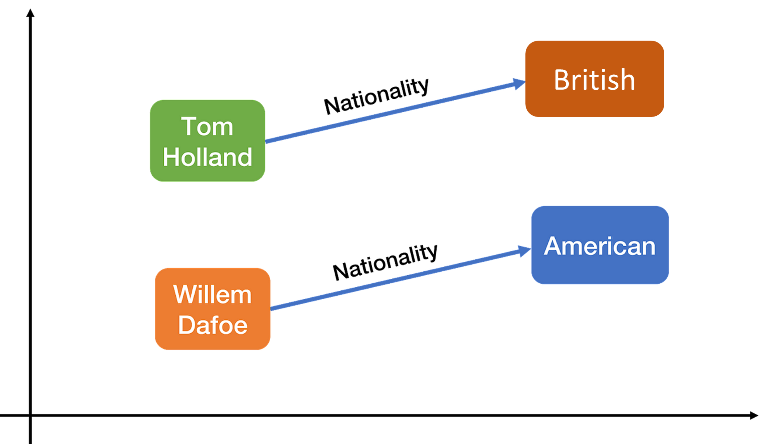
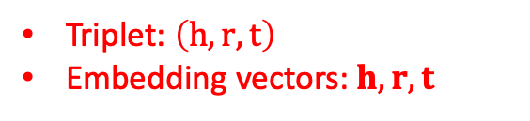
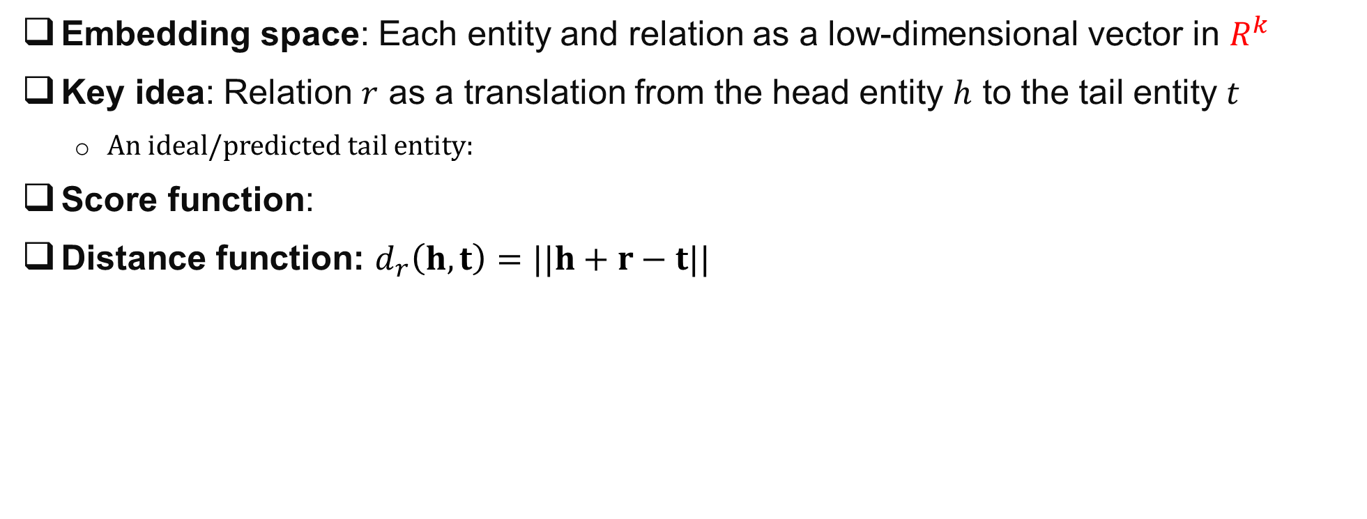
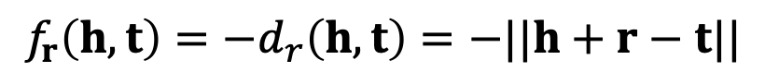
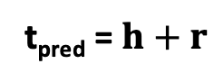
KG Embedding Method #1: TransE
Embedding space: Each entity and relation as a low-dimensional vector in $R^{k}$
Key idea: Relation $r$ as a translation from the head entity $h$ to the tail entity $t$
An ideal/predicted tail entity:
Score function:
Distance function: $d_{r}\left(h,t\right)=||h+r−t||$
t_{pred} = $h+r$
$${f_{r}\left(h,t\right)=−d}_{r}\left(h,t\right)=−||h+r−t||$$
Triplet: $\left(h,r, t\right)$
Embedding vectors: $h, r, t$
[1] A. Bordes, N. Usunier, and A. Garcia-Duran. 2013. Translating Embeddings for Modeling Multi-relational Data (NeurIPS 13).
Notes:
Many KG embedding methods have been developed. Here, we introduce the most representative one.
The basic idea of TransE is to view the relation r as the transition from the head entity to the tail entity. Mathematically, it means that ideally, the tail entity t should be the summation of the head entity and the relation.
An example of transE is the relation ‘Nationality’, as shown here on the right side. In this example, we expect the embedding of the tail entity (English) can be obtained by adding the embedding of Tom Holland and the embedding of the relation (nationality) together.
Naturally, we can define the score function as the negative distance between the ideal translation (h+r) which is the ideal tail entity, and the actually tail entity

Slide 19
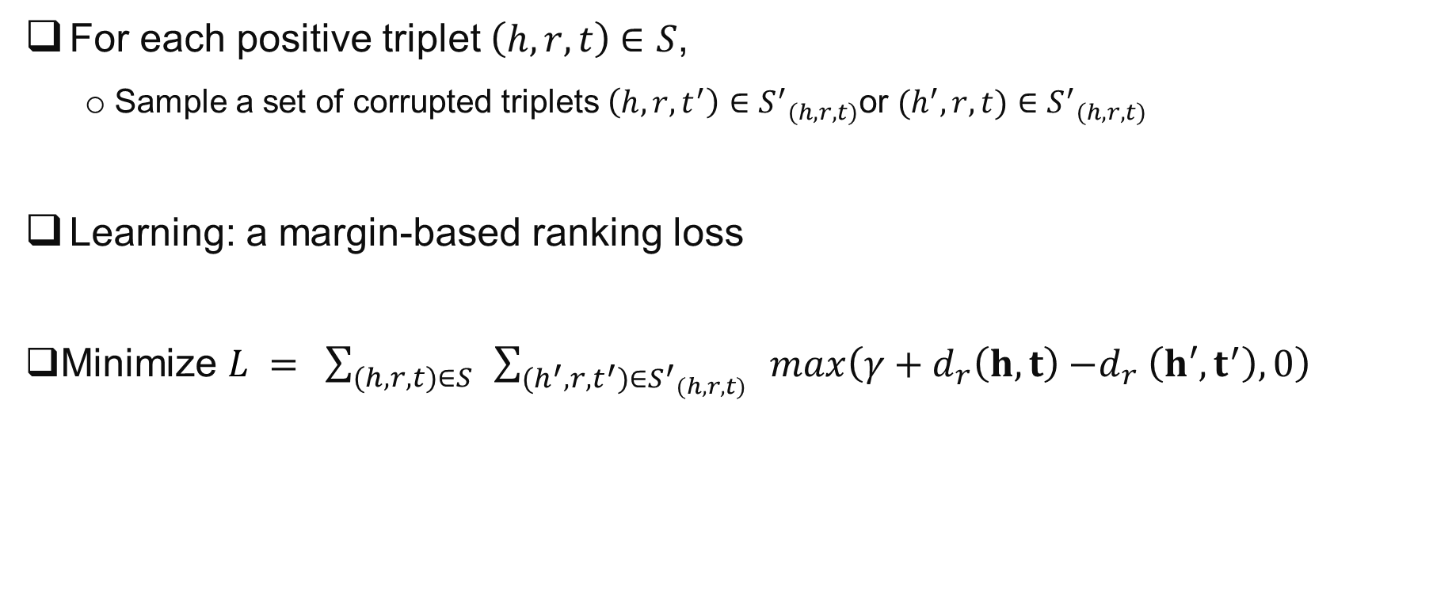
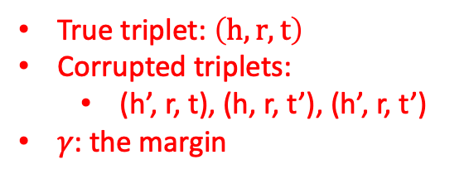

TransE: Training Process
For each positive triplet $\left(h, r, t\right)$ $∈S$,
Sample a set of corrupted triplets $\left(h,r,t^{′}\right)∈{S^{′}}_{(h, r, t)}$or $(h^{′},r,t)∈{S^{′}}_{(h, r, t)}$
Learning: a margin-based ranking loss
Minimize $L ={\sum_{(h, r, t)∈S}{ }\sum_{(h^{′},r,t^{′})∈{S^{′}}_{(h, r, t)}}{ }max\left(γ+d_{r}\left(h,t\right){−d}_{r}\left(h′,t^{′}\right), 0\right)}$
True triplet: $\left(h,r, t\right)$
Corrupted triplets:
(h’, r, t), (h, r, t’), (h’, r, t’)
𝛾: the margin
Margin: gap should be at least $γ$
[1] A. Bordes, N. Usunier, and A. Garcia-Duran. 2013. Translating Embeddings for Modeling Multi-relational Data (NeurIPS 13).
Notes:
During the learning process, for each positive triplet, the model will sample a set of corrupted triplets and treat them as negative samples.
The corrupted triplets are got by randomly replacing the head entity or the tail entity of the positive triplet.
The loss function used by transE is the margin-based ranking loss.
The loss function favors lower values of the distance for positive triplets than for corrupted triplet, and the margin can make sure that their gap should be at least gamma.

Slide 20
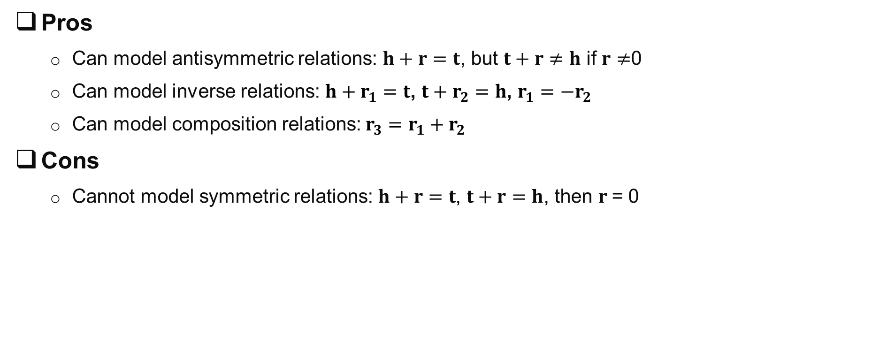
TransE: Key Properties
Pros
Can model antisymmetric relations: $h+r=t$, but $t+r≠h$ if $r≠$0
Can model inverse relations: $h+r_{1}=t$, $t+r_{2}=h$, $r_{1}=−r_{2}$
Can model composition relations: $r_{3}=r_{1}+r_{2}$
Cons
Cannot model symmetric relations: $h+r=t$, $t+r=h$, then $r$= 0
[1] A. Bordes, N. Usunier, and A. Garcia-Duran. 2013. Translating Embeddings for Modeling Multi-relational Data (NeurIPS 13).
Notes:
The idea of transE is very intuitive. A natural question is what kind of relationships this kind of approach is able to learn. It turns out it can indeed model most of the relation patterns we introduced before.
For example,
TransE is able to model antisymmetric relations, because if h plus r is equal to t, the same relation cannot hold in the opposite direction as long as r is not a zero vector (i.e., t plus r is not equal to h when r is not equal to 0).
Furthermore, transE can model inverse relations as long as one relation is the negation of the other, i.e., $r_{1}=−r_{2}$
Moreover, transE can model composition relations as long as the third relation is the sum of the first two relations, i.e., $r_{3}=r_{1}+r_{2}$
However, transE could not capture symmetric relations. This is because, if the same relation r holds for both directions (i.e., $h+r=t$, $t+r=h$), the only way to do this is make r=0 and t=h. which is not desirable because
First, it means that h and t have the same embedding albert h and t are different entities.
Second, it forces all the symmetric relations to share the same embedding (a zero vector) albeit there are many different kinds of symmetric relations (sibling of, friends of, classmates of, enemy of, etc.)
Both of these two facts limit the modeling capability of transE

Slide 21


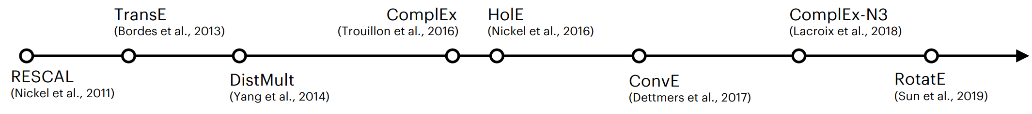
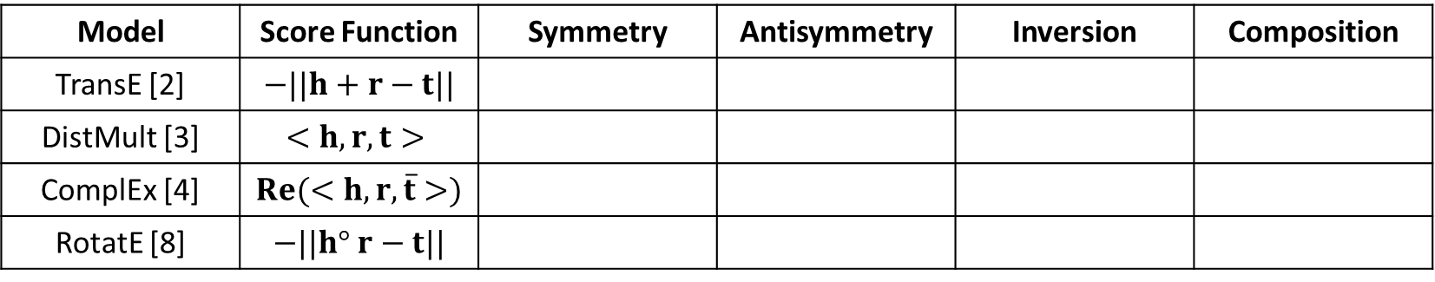
Knowledge Graph Embedding: Summary
Model | Score Function | Symmetry | Antisymmetry | Inversion | Composition
TransE [2] | $$−||h+r−t||$$
DistMult [3] | $$<h, r, t>$$
ComplEx [4] | $$Re(<h, r,\overline{t}>)$$
RotatE [8] | $$−||h° r−t||$$
(Some) KGE models in recent literature:
[1] M. Nickel, V. Tresp, and H. Kriegel. 2011. A Three-Way Model for Collective Learning on Multi-Relational Data (NeurIPS 11).
[2] A. Bordes, N. Usunier, and A. Garcia-Duran. 2013. Translating Embeddings for Modeling Multi-relational Data (NeurIPS 13).
[3] B. Yang, W. Yih, X. He, J. Gao, and L. Deng. 2014. Embedding Entities and Relations for Learning and Inference in Knowledge Bases (ICLR 15).
[4] T. Trouillon, J. Welbl, S. Riedel, E. Gaussier, and G Bouchard. 2016. Complex Embeddings for Simple Link Prediction (ICML 16).
[5] M. Nickel, L. Rosasco, and T. Poggio. 2016. Holographic Embeddings of Knowledge Graphs (AAAI 16).
[6] Tim Dettmers, Pasquale Minervini, Pontus Stenetorp, Sebastian Riedel. 2018. Convolutional 2D Knowledge Graph Embeddings (AAAI 18).
[7] T. Lacroix, N. Usunier, G. Obozinski. 2018. Canonical Tensor Decomposition for Knowledge Base Completion (PMLR 2018).
[8] Z. Sun, Z. Deng, J. Nie, and J. Tang. 2019. RotatE: Knowledge Graph Embedding by Relational Rotation in Complex Space (ICLR 19).
Notes:
Here is a comparison of different kg embedding methods in terms of modeling the four commonly seen relations.
Beyond the four methods we introduce, there are many other kg embedding methods, such as RESCAL ConvE. For the interest of time, we will not introduce each of them. If you are interested, you can check the related references listed at the bottom

Slide 22
Overview of Part I
Basic Concepts and Techniques
Knowledge Graph Embedding
Rule Based Knowledge Graph Reasoning
Path Based Knowledge Graph Reasoning
Inductive Rule Mining
TransE
Hard Rule Based Reasoning
Path Ranking
Chain-like Rules
Subgraph Rules
Notes:
In this part, I will introduce the General Knowledge Graph Reasoning from 4 categories, Knowledge Graph Embedding, xxxxx, path xxx, and xxx.
Now, let’s see the first category knowledge graph embedding.

Slide 23
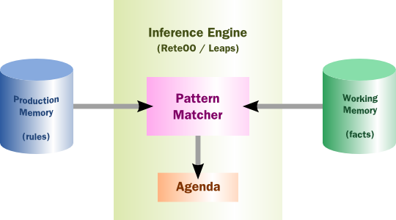
Rule-based Expert System
Key idea: Apply rules iteratively to generate new facts
New facts represent conclusions about the state of the domain given the observations
Major components
The inference engine
The knowledge bases and rules
[1] H. Roth, F. Waterman, and D. Arthur. 1936. Building expert systems (Addison-Wesley 36).
Notes:
One of the earliest hard rule based reasoning system is rule-based expert system.
It can be tracked to 1970s.
The key idea of Rule-based Expert System is to apply hard rules iteratively to generate new facts.
It is a very straightforward method.
Generally, there are three primary components in ruled-based expert system: the inference engine, the knowledge base and the rules defined by experts.

Slide 24
Inference Engine
Brain of the reasoning system
Inferring knowledge by applying forward or backward chaining
Forward chaining (data driven)
Start with facts, determine applicable rules, and apply one
Repeat until no more rules can be applied
Backward chaining (goal oriented) :
Give a goal, rules are applied by matching the goal to infer the answer
E.g. (Alan Turing, wasBorn, ?)

Slide 25
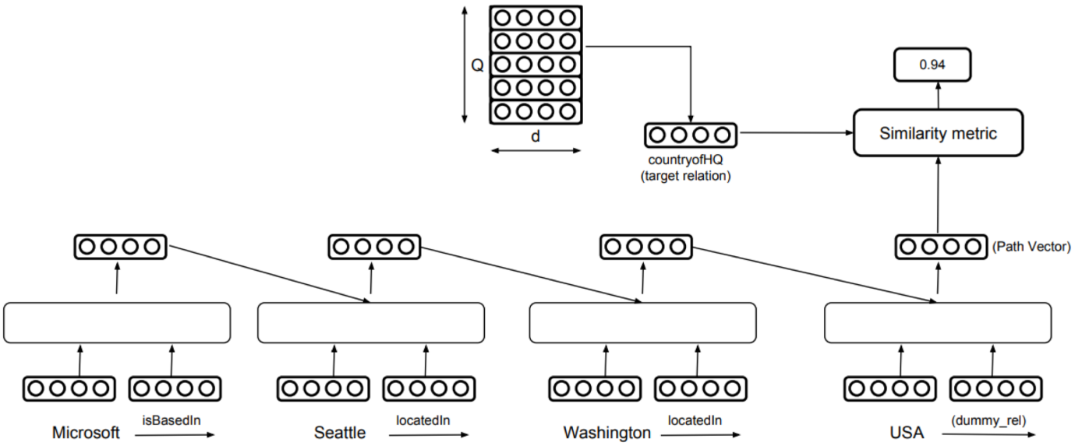
Path Based Knowledge Graph Reasoning
Logical rule reasoning
Require given logic rules as input
Path-based reasoning
Involves traversing paths in a KG to infer new information
Paths can be directed or undirected
[1] N. Lao, T. Mitchell, and W. Cohen. 2011. Random walk inference and learning in a large scale knowledge base (ACL 11).
[2] H. Wang, H. Ren, and J. Leskovec. 2021. Relational message passing for knowledge graph completion (KDD 21).
[3] W. Xiong, T. Hoang, and WY. Wang. 2017. Deeppath: A reinforcement learning method for knowledge graph reasoning (ACL 17).
Notes:
For the rule based reasoning methods, they require the rule is given.
However, it’s not the case usually. We don’t have any rules. One possible solution is path-based reasoning.
For the path based reasoning method, No rule is needed. It utilize different paths in the knowledge graph to infer new information.
These paths can be directed or undirected.

Slide 26
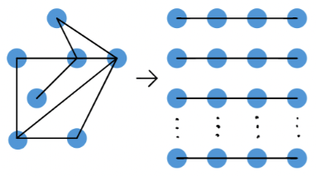
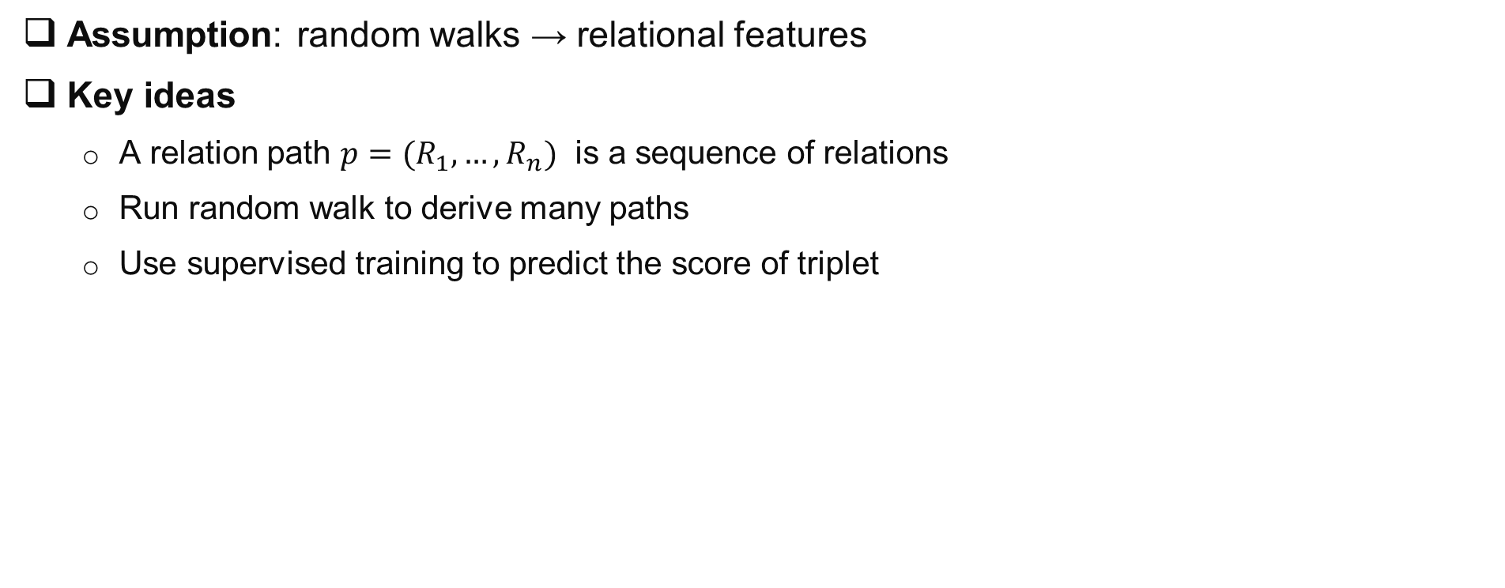
PRA: Reasoning with Random Walks
Assumption: random walks → relational features
Key ideas
A relation path ${p=(R}_{1},…,R_{n})$ is a sequence of relations
Run random walk to derive many paths
Use supervised training to predict the score of triplet
 | Path 1 | Path 2 | … | Path n | Label
Query 1 | Score 1.1 | Score 1.2 | … | Score 1.n | y1
Query 2 | … | … | … | … | y2
… | … | … | … | … | …
Query k | Score k.1 | Score k.2 | … | Score k.n | yk
[1] N. Lao, T. Mitchell, and W. Cohen. 2011. Random walk inference and learning in a large scale knowledge base (ACL 11).
Notes:
The very first method of path reasoning is path ranking algorithm which treats the random walks around a query node as the relational features.
The idea of PRA (path ranking algorithm) is to use random walk to find many different paths between two nodes, and treat these paths as the feature of the relation, and use a logistic regression model to learn a classifier to predict the score of the triplet.

Slide 27
Related works
Rule based knowledge graph reasoning
M. Richardson, and P. Domingos. 2006. Markov Logic Networks (Machine learning 16).
W. Cohen. 2016. TensorLog: A Differentiable Deductive Database (arXiv 16).
P. Cheng, P. Liu, P. Wang, P. Sun. 2022. RLogic: Recursive Logical Rule Learning from Knowledge Graphs (KDD 22).
…
Path based knowledge graph reasoning
H. Wang, H. Ren, and J. Leskovec. 2021. Relational message passing for knowledge graph completion (KDD 21).
W. Xiong, T. Hoang, and WY. Wang. 2017. DeepPath: A reinforcement learning method for knowledge graph reasoning (ACL 17).
M. Qu, J. Chen, J. Tang. 2021. RNNLogic: Learning logic rules for reasoning on knowledge graphs (ICLR 21).
…
Notes:
The very first method of path reasoning is path ranking algorithm which treats the random walks around a query node as the relational features.
The idea of PRA (path ranking algorithm) is to use random walk to find many different paths between two nodes, and treat these paths as the feature of the relation, and use a logistic regression model to learn a classifier to predict the score of the triplet.

Slide 28
Overview of Part I
Basic Concepts and Techniques
Knowledge Graph Embedding
Rule Based Knowledge Graph Reasoning
Path Based Knowledge Graph Reasoning
Inductive Rule Mining
TransE
Hard Rule Based Reasoning
Path Ranking
Chain-like Rules
Subgraph Rules
Notes:
In this part, I will introduce the General Knowledge Graph Reasoning from 4 categories, Knowledge Graph Embedding, xxxxx, path xxx, and xxx.
Now, let’s see the first category knowledge graph embedding.

Slide 29
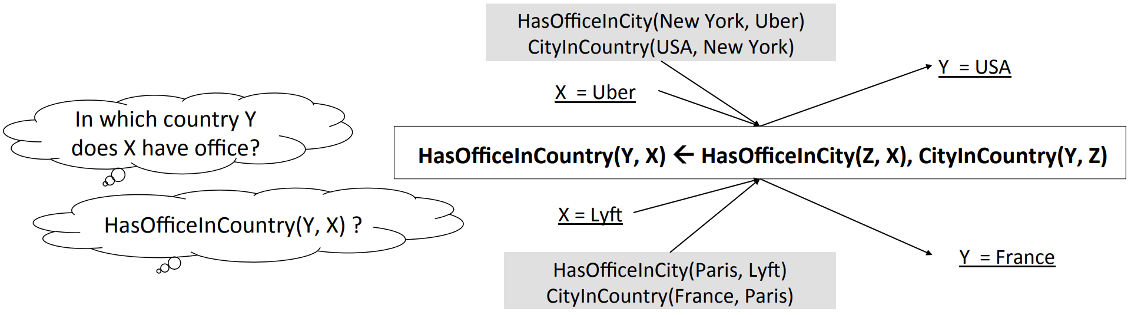
Why Mining Logical Rules?
Goal: Extract general and meaningful rules that can be applied to new, unseen data.
Advantages of mining logical rules
Logical rules have the potential to generalize well
Logical rules are explainable and understandable
[1] F. Yang, Z. Yang, W. Cohen. 2017. Differentiable Learning of Logical Rules for Knowledge Base Reasoning (NeurIPS 17).
Notes:
Logical rule mining aims to extract general and meaningful rules from the knowledge graph, so that these rules can be applied to reason new, unseen data.
Logic rule mining has many advantages.
For example, Logical rules have the potential to generalize well, the rules mined in one knowledge graph can be applied to other similar knowledge graph.
Besides, Logical rules are explainable and understandable, it makes the reasoning process more interpretable.

Slide 30
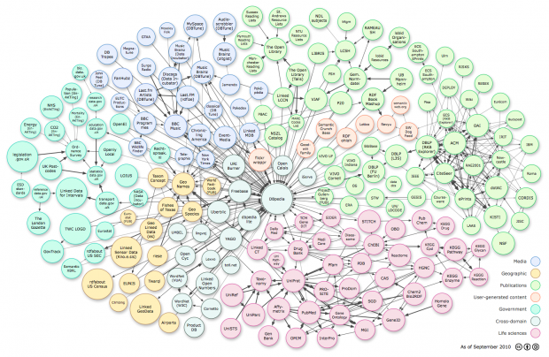
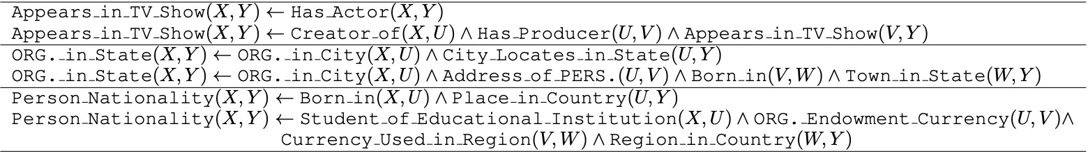
Inductive Rule Mining
Process of inductive rule mining
Rule generation: Use a rule mining algorithm to discover interesting rules from the dataset
Rule evaluation: Assess the quality and relevance of the generated rules.
[1] M. Qu, Z. Zhu, J. Tang. 2022. Reasoning on Knowledge Graphs: Symbolic or Neural? (AAAI 22).
Notes:
The Process of Inductive Rule Mining commonly contains two tasks, rule generation and rule evaluation.
Rule generation will Use a rule mining algorithm to discover interesting rules from the dataset.
While rule evaluation assess the quality and relevance of the generated rules.

Slide 31
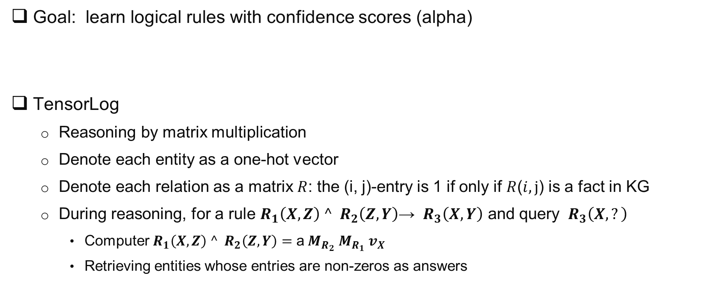
Neural LP
Goal: learn logical rules with confidence scores (alpha)
TensorLog
Reasoning by matrix multiplication
Denote each entity as a one-hot vector
Denote each relation as a matrix $R$: the (i, j)-entry is 1 if only if $R$($i, j$) is a fact in KG
During reasoning, for a rule $R_{1}{{\left(X, Z\right)}^{ }^}^{ }{ R}_{2}\left(Z,Y\right)$→ ${ R}_{3}\left(X,Y\right)$ and query ${ R}_{3}\left(X,?\right)$
Computer $R_{1}{{\left(X, Z\right)}^{ }^}^{ }{ R}_{2}\left(Z,Y\right)=\text{a}{ M}_{R_{2}}{ M}_{R_{1}}{ v}_{X}$
Retrieving entities whose entries are non-zeros as answers
Notes:
Neural LP focuses on learning logical rules with confidence scores.
In Neural LP , the reasoning process is a sequence of matrix multppilication operations.
Neural LP Denote each relation as a matrix $R$, and input query entity as a one-hot vector.
The reasoning results is computered by the matrix multppilication.
Retrieving entities whose entries are non-zeros as answers

Slide 32




Neural LP: Key Ideas
From length 2 to length ${ l}_{ }$ :
$R_{1}{{\left(X, Z\right)}^{ }^}^{ }{ R}_{2}\left(Z,Y\right)={ M}_{R_{2}}{ M}_{R_{1}}{ v}_{X}$ → $R_{1}{{\left(X, Z\right)}^{ }^}^{ }…{^R}_{l}\left(Q,Y\right)= \sum_{l}{{\text{α}}_{l}\prod_{k∈β_{l}}{{ M}_{R_{k}}}}v_{X}$
Objective function of all entity pairs
Differentiable rules
Exchange product and sum: $\sum_{l}{{\text{α}}_{l}\prod_{k∈β_{l}}{{ M}_{R_{k}}}}\text{→}$
Now learning a single rule, each step is combination of relationships
Notes:
When genralizing the rule length from 2 to L, we just need to do more multipications.
In neural LP, the authors found that the first sum then multiplication operations in the loss function can be exchanged to first multiplication then sum.
After changing the order of the operations, the original matrix multiplication process become to learn the combination of relationships at each step.

Slide 33



Neural LP: Key Ideas
Differentiable rules
Now learning a single rule, each step is combination of relationships
Recurrent neural network for T step
First summation, then multiplication
Box 1
Box 2
[1] F. Yang, Z. Yang, W. Cohen. 2017. Differentiable Learning of Logical Rules for Knowledge Base Reasoning (NeurIPS 17).
Notes:
If we check this formula carefully, we will find it contains T steps in total, and for each step, it’s a weighted matrix summation with some unknow weight parameters alpha.
It is natural to model this process by a Recurrent neural network for T step.
At each step, the Recurrent neural network will learn the parameter of a_t and belta_t in Box 1.
At the same time, the variable representation will be updated according to the formula in Box 2.
The final output is u_(capital T plus 1) in Box 2.
Just like traditional Recurrent neural network, Neural LP learns the parameters by gradient descent.

Slide 34


GraIL: Subgraph Reasoning
Observation
Useful rules contained in the subgraph around query
Key ideas:
Idea 1: Apply graph neural networks (GNNs) on the subgraphs surrounding candidate edge.
Idea 2: Subgraph reasoning avoids explicit rule induction.
Idea 3: Ensure model is expressive enough to capture logical rules.
[1] K. Teru, E. Denis, W.L. Hamilton. 2020. Inductive Relation Prediction by Subgraph Reasoning (ICML 20).
Notes:
For all the previous methods, they focus on utilizing horn clauses to do reasoning.
In this method, the authors try to use subgraph to do reasoning.
Because the useful rules will also be contained in the subgraph around the query.
The idea of GRAIL is to apply graph neural networks (GNNs) on the subgraphs surrounding the candidate edge.
The hypothesis is that the subgraph structure have the evidence to infer the relation between two nodes.
The gnn based method can avoid explicit rule induction
And at the same time, the model is expressive enough to capture logical rules. .

Slide 35

GraIL: Example
1. Extract subgraph around candidate edge
2. Assign structural labels to nodes
3. Run GNN on the extracted subgraph
[1] K. Teru, E. Denis, W.L. Hamilton. 2020. Inductive Relation Prediction by Subgraph Reasoning (ICML 20).
Notes:
Now, let’s look at the details of GraIL.
The reasoning step composites three steps in total.
In the first step, we extract a subgraph around candidate edge (the goal is to reasoning the candidate edge according to the rules or pattern in the subgraph. ). In this example, the green edge is the predicate we want to reason about.
And the red paths is the subgraph around the candidate, the goal is to reasoning the candidate edge according to the rules or pattern in the subgraph.
At the second step, we assign structural labels to the nodes.
Each node is labelled by the distance from the target nodes. This helps encode the substructure of the graph.
In the final step, we run a gnn on the extract subgraph which is expressive enough to capture the rules.

Slide 36
Roadmap
Part I: Knowledge Graph Reasoning: Basic Concepts and Techniques
Part II: Recent Advance #1: Neural Reasoning for Natural Language Queries
Part III: Recent Advance #2: Neural Reasoning for Logical Queries
Part IV: Recent Advance #3: Neural Reasoning Beyond Entities and Relations
Part V: Recent Advance #4: LLM+KGR
Part VI: Open Challenges and Future Directions
Notes:
Today’s tutorial contains 4 parts.
At the beginning, I would like to give some background regarding the knowledge graph reasoning as well as the unique challenges behind this problem setting.
In part 1, we will introduce the details of general knowledge graph reasoning. and in part 2, we will introduce query specific knowledge graph reasoning. And finally, we will discuss the future trends for knowledge graph reasoning.

Slide 37
Overview of Part II
Reasoning for Different Query Types
Reasoning for Multi-hop Queries
Reasoning for Conversational Queries
EmbedKGQA
Conquer
BiNet
Praline

Slide 38
Preliminary: KGQA
KGQA definition
Given: (1) a natural language question (2) the topic entity, and (3) a knowledge graph
Find: a set of nodes of the knowledge graph to answer the question
Multi-hop question (the focus of this part)
Can be transformed to a path on KG
Example: “what is the language of the film directed by Steven Spielberg?”
Other types of questions
One-hop question: “What is the genre of Interstellar?”
Logic query: “Where did Canadian citizens with Turing Award graduate?”
Many more
[1] H. Ren, W. Hu, J. Leskovec. 2020. Query2box: Reasoning over Knowledge Graphs in Vector Space using Box Embeddings (ICLR 20).
[2] H. Xiao, J. Zhang, D. Li, P. Li. 2019. Knowledge Graph Embedding Based Question Answering (WSDM 19).
[3] A. Saxena, A. Tripathi, P. Talukdar. 2020. Improving Multi-hop Question Answering over Knowledge Graphs using Knowledge Base Embeddings (ACL 20)

Slide 39


Key Challenge: KG Sparsity & Incompleteness
Knowledge graphs are sparse & incomplete
Break of the reasoning chain
Increase the length of reasoning path
Possible solutions
#1: Use additional data e.g., text corpus
But text not always available
#2: Impose neighborhood limits
But the answer might be out of reach.
Q: What’s the genre of movies directed by Louis Mellis?
[1] A. Saxena, A. Tripathi, P. Talukdar. 2020. Improving Multi-hop Question Answering over Knowledge Graphs using Knowledge Base Embeddings (ACL 20)
Notes:
However, most real world knowledge graphs are sparse and incomplete with missing relations, which makes kgqa hard to solve.
In the part I, we have introduced rule based reasoning methods and path based reasoning methods, when applying them to KGQA, their reasoning chain might be broken due to the KG incompleteness.
Besides, the incompleteness makes the KGQA model potentially needs to reason over a longer path over the KG which significantly increases the search space.
In this example, given a question: What’s the genre of movies directed by Louis Mellis?
Without the ‘has_genre’ relation from gangster no1 to crime, kgqa would need to reason over a long path (from louis to gangster no 1 to gangs, to the departed to crime)
Some prior work suggested a possible solution by leveraging additional data such as additional text corpus, which is not always available
Another possible solution, used by the prior multi-hop kgqa, is to impose neighborhood limit – to restrict the search within k-hop neighbors (that is the shaded area in the figure). But this often makes the true answer (Crime in this example) out of reach

Slide 40

EmbedKGQA: Overview
Key ideas
Embeds question & the entities of the KG in a vector space
Performs QA using these embeddings
Benefits
Deal with KG sparsity & incompleteness
Bypass the neighborhood limits
[1] A. Saxena, A. Tripathi, P. Talukdar. 2020. Improving Multi-hop Question Answering over Knowledge Graphs using Knowledge Base Embeddings (ACL 20)
Notes:
embedKGQA addresses this challenge by performing multi-hop question answering in the embedding space. The key ideas are as follows
We first embed both the question & the entities of the knowledge graph in a continuous vector space.
Then, we can perform question answering using these embeddings.
In this way, it naturally deals with the sparsity & incompleteness challenge, and it also bypass a neighborhood size limit (that is the need to choose k for the neighbor size as required by previous multi-hop kgqa methods)

Slide 41


EmbedKGQA: Details
1
3
4
2
1
Find question embedding e_{q} by FFNN
Find entity embeddings by KG Embedding (ComplEx, See Part 1)
topic entity e_{h} and answer entity e_{a}
Score question e_{q}, topic entity e_{h} and answer e_{a} (ComplEx)
$φ(e_{q},e_{h},e_{a})$
Select answer $\hat{a}={argmax}_{a}φ(e_{q},e_{h},e_{a})$
2
3
4
[1] A. Saxena, A. Tripathi, P. Talukdar. 2020. Improving Multi-hop Question Answering over Knowledge Graphs using Knowledge Base Embeddings (ACL 20)
Notes:
In details, embedkgqa has the following key steps.
First, It finds the question embedding by a feedforward nn, which
first embeds the question q using RoBERTa into a 768-dimensional vector. I
t is then passed through 4 fully connected linear layers with ReLU activation and
finally projected onto the complex space
Then, It finds the embedding of all entities of the input kg.
We have introduced kg embedding in part 1, many choices exist. In embedkgqa paper, it uses complex).
This will give us (1) the embedding of the topic entity of the question e_h, and (2) the embedding of the answer entity of the question e_a
Then, we can score the goodness of the triple: the question, the topic entity and the answer. Again, many score functions we introduced in kg embedding exist. This paper again uses the score function of complex. The idea is that for a triple with a given question, its topic entity, and its true answer should score higher than for a negative triple (wrong answer)
Finally, for a new question and its topic entitry, we select the answer that gives the highest score among all the possible ansnwers/entities in kg

Slide 42






KG Completion vs. EmbedKGQA
KGC (predict missing tail entity)
Problem definition
Given: the head h, the relation r, and KG
Predict: missing tail entity
How-to (see Part 1)
Choose a score function $fr$($h,t$)
Find embeddings for all entities and relations
Predict the tail entity
EmbedKGQA (answer multi-hop question)
Problem definition
Given: the question, its topic entity, and KG
Predict: missing answer entity
How-to
Find question embedding $e_{q}$by FFNN
Choose a score function $φ(e_{q},e_{h},e_{a})$
Find embeddings for all entities
Predict the answer entity
$$\hat{t}={argmax}_{t}fr(h,t)$$
$$\hat{a}={argmax}_{a}φ(e_{q},e_{h},e_{a})$$
EmbedKGQA is essentially a KGC task to predict the missing tail entity, by
Treating (1) the topic entity as the head entity, and (2) the question as a special type of relation
Finding the question/relation embedding by FFNN (not via KG embedding)
[1] A. Saxena, A. Tripathi, P. Talukdar. 2020. Improving Multi-hop Question Answering over Knowledge Graphs using Knowledge Base Embeddings (ACL 20)
vs.
Notes:
Let’s make a conceptual comparison between kgc (which we introduced in part 1) and embedkgqa.
In kgc, suppose we want to predict the missing tail entity t, given the head entity h and the relation r,
The idea is to choose a score function which takes the triplet embedding as input and outputs a score for each triplets.
The score of the positive triplets should be higher than that of negative triplets.
Now, let’s look at embedkgqa
In embedkgqa, given, the question, its topic entity and KG, we want to predict the missing answer entity.
As introduced before, Embedkgqa has the following key steps,
It first uses a Roberta model to learn the question embedding, then uses method complex to calculate the score for the (topic entity, the question, and candidate answer entity).
In other words, what embedkgqa does is essentially a kgc task to predict the missing tail entity, if
We view the topic entity as the head entity h
We view the whole question

Slide 43
Insight #1: KGQA can Help KGC
Want to predict (A Song of Love, releaseYear, ?)
Hard to answer
"which years were all the films directed by Jean Genet released?”
Answer: 1950
Missing
Predict: (A Song of Love, releaseYear, 1950)
Because Jean Genet directed “A Song of Love”
And Jean Genet only directed one movie in his life
[1] L. Liu, B. Du, J. Xu, Y. Xia, H. Tong. 2022. Joint Knowledge Graph Completion and Question Answering (KDD 22).
Notes:
now that we have seen the connection between kgc and kgqa, a natural question is if these two tasks can mutually benefit from each other.
First, we found that KGQA can help KGC. For example, if we want to predict which year was the movie A Song of Love released xx.

Slide 44
Insight #2: KGC can Help KGQA
Question: “what is the language of the film The Love of Siam”
Hard to answer
Easy to answer
Missing
After completion
[1] L. Liu, B. Du, J. Xu, Y. Xia, H. Tong. 2022. Joint Knowledge Graph Completion and Question Answering (KDD 22).
Notes:
Besides, KGC can help KGQA. For example, if we want to answer the question “what is the language of the film The Love of Siam”. Given the incomplete knowledge graph on the left hand of this slides, we find the answer is hard to predict. Because the relation between xxx.

Slide 45


Theoretical Analysis
Main claim/insight: Knowledge graph completion is a special case of multi-hop question answering.
Knowledge graph completion: 𝑃𝑟($t$|$h$, $r_{1}$)
Multi-hop question answering:
𝑃𝑟($t$|$h$, $r_{1}$, $r_{2}$, .., $r_{n}$) = 𝑃𝑟($a_{1}$| $h$, $r_{1}$) 𝑃𝑟($a_{2}$|$a_{1}$, $r_{2}$) … 𝑃𝑟($t$|$a_{n−1}$, $r_{n}$)
Maximize 𝑃𝑟($t$|$h$, $r_{1}$) → maximize 𝑃𝑟($t$|$h$, $r_{1}$, $r_{2}$, .., $r_{n}$)
Maximize 𝑃𝑟($t$|$h$, $r_{1}$, $r_{2}$, .., $r_{n}$) → 𝑃𝑟($t$|$h$, $r_{1}$)
Question: whether can jointly perform KGC & KGQA in a mutually beneficial way?
[1] Apoorv Saxena et.al. 2020. Improving Multi-hop Question Answering over Knowledge Graphs using Knowledge Base Embeddings (ACL 20)
[2] Antoine Bordes, Nicolas Usunier, Alberto Garcia-Duran, Jason Weston, Oksana Yakhnenko. 2013. Translating Embeddings for Modeling Multi-relational Data(NIPS 13).
Notes:
From the theoretical perspective, it is also easy to prove why they can help each other.
We first conduct some theoretical analysis to discuss the relationship between knowledge graph completion and multi-hop question answering.
The completion task can be interpreted as maximize the probability that getting tail entity condition on the head entity and relation.
The multi-hop question answering task can be interpreted as maximize the multiplication of several components, while each component is equavelent to the corresponiding completion task.
Essentially, maixze the KGC probability will maixizing the question answering probability at the same time, and vice versa.
This inspires use to ask a question “whether can jointly perform KGC & KGQA in a mutually beneficial way?”

Slide 46

BiNet: Key Ideas
Question #1: How can KGC help KGQA
Our solution: Share latent features
Formulate it as a multi-task learning problem
Pre-train embedding by KGC
Multi-hop KGQA and KGC
Share the embedding space and the answer scoring module
Automatically share latent features and reinforce each other
Shared by KGC and KGQA
Notes:
To solve this problem, we question we need to ask is How can KGC help KGQA.
The solution is to let the KGC and KGQA use a Share latent features.
This can be formulated as a multi-task learning problem

Slide 47


BiNet: Key Ideas
Question #2: How can KGQA help KGC
Our solution: Path based completion
Transform the natural language question to a path in the knowledge graph
Complete the knowledge graph according to ($v, P, a$)
$v$: topic entity in the natural language question
$P$: the path
$a$: the answer
Notes:
To solve the second challenge, the The key idea is

Slide 48


BiNet: Model Overview
Part1 (Path Decoder): Using an Encoder-Decoder model to transform the natural language to a path $P$
Part2 (Answer Scoring): Using $P$to complete the knowledge graph. Finding 𝑘 answer candidates by the answer scoring module
Part3 (Answer Refinement): Re-rank answers by Transformer Encoder
Part1
Part2
Part3
[1] L. Liu, B. Du, J. Xu, Y. Xia, H. Tong. 2022. Joint Knowledge Graph Completion and Question Answering (KDD 22).
Notes:
The proposed binet contains three parts in total.

Slide 49

BiNet: Experiment
MetaQA: Question answering accuracy
Observations
An average advantage of 2.5% on 50% KG and an average advantage of 3.5% on 30% KG
For sparse KG, BiNet outperforms baseline more
For longer path questions, BiNet outperforms baselines more
[1] L. Liu, B. Du, J. Xu, Y. Xia, H. Tong. 2022. Joint Knowledge Graph Completion and Question Answering (KDD 22).
Notes:
In the experiment, the author compared BiNet with several baselines methods, the table shows the accuracy of questoinanswering on dataset MetaQA.
We can observe that Binet has an average advantage of 2.5% on 50% KG and an average advantage of 3.5% on 30% KG. when the KG becomes sparse, BiNet outperforms baseline more. When the question path becomes longer, BiNet outperforms baselines more.

Slide 50
Overview of Part II
Reasoning for Different Query Types
Reasoning for Multi-hop Queries
Reasoning for Conversational Queries
EmbedKGQA
Conquer
BiNet
Praline

Slide 51

ConvQA over Knowledge Graphs
An example
Key challenges
Short, incomplete questions
Implicit context
[1] M. Kaiser, R. Saha Roy, and G. Weikum. 2021. Reinforcement Learning from Reformulations in Conversational Question Answering over Knowledge Graphs (SIGIR 21)
Notes:
Now, let’s look at the first method for iterative reasoning.
On blue dialog boxes on the right, the user asks some questions about marvel movies, and on the gray dialog boxes, they are the correct system responses.
Answering such questions can be challenging. Because these questions can be short, incomplete, and sometimes the contexts are implicit.
For example, for answer question 3 and 4, we need to know they both refer to the movie mentioned in the second answer, which is spider-man.

Slide 52

Realistic Conversation
Challenges
Short, incomplete questions
Implicit context
Learn from conversational stream
Reformulation = Wrong answer
New intent = Correct answer
[1] M. Kaiser, R. Saha Roy, and G. Weikum. 2021. Reinforcement Learning from Reformulations in Conversational Question Answering over Knowledge Graphs (SIGIR 21)
Notes:
In real world, a more real conversation looks like the example in the right hand side of this slides,
the system answers the first question correctly, but has problem answering the second one.
However, users might easy to guess that this is not a marvel movie, and therefore, tries again, ask the same question in a different way.
And after another attempt, the system finds the correct answer.
This is a more correct scenario. Whenever, there is a reformulation, we assume that the previous answer was wrong.
And when there is a new intent, it’s more like that the previous answer was correct.

Slide 53

Conquer: Key Ideas
Key ideas: Reinforcement learning
Multiple agents
Rewards based on implicit feedback in form of question reformulations
Reformulation predictor: classify the follow-up question as a reformulation or new intent
Architecture
[1] M. Kaiser, R. Saha Roy, and G. Weikum. 2021. Reinforcement Learning from Reformulations in Conversational Question Answering over Knowledge Graphs (SIGIR 21)
Notes:
Based on the previous observation, this method treats reformulations as implicit feedback to train a reinforcement learning model.
The idea of conquest is to position multiple reinforcement learning agents on relevant entities. These agents can then traverse the knowledge graph to provide answers within their neighborhoods.
In this example, one agent walks from Aveger endgemagem to spider man which is the correct answer for this question.
The reward of the agent is based on implicit feedback in form of question reformulations. If the reformulation predictor thinks the follow-up question as a reformulation, the agent which gets negative reward,
Otherwise, the reward is positive.

Slide 54

Conquer: Context Entity Detection
Goal: Find entities relevant to current question and its conversational context
Context entities will be start-points for the RL walk
Get initial entities from first complete question via NED tool
[1] M. Kaiser, R. Saha Roy, and G. Weikum. 2021. Reinforcement Learning from Reformulations in Conversational Question Answering over Knowledge Graphs (SIGIR 21)
Notes:
The proposed conquer contains several steps, the first step is to detect context entities of the question.
For example, for the question “when was Avengers: Endgame released in Germany?”. The context entity is Avengers: Endgame.
These entities are relevant to the current question and the conversation context.
They will serve as the start-points of the reinforcement learning walk.

Slide 55

Conquer: Path Prediction
Goal: Predict for each agent which path it should take
Idea: MDP
States: current question, context entity, conversation history (optional)
Actions: all outgoing paths from the context entity node
Rewards: 1 if next question is a new intent, -1 if it is a reformulation
[1] M. Kaiser, R. Saha Roy, and G. Weikum. 2021. Reinforcement Learning from Reformulations in Conversational Question Answering over Knowledge Graphs (SIGIR 21)
Notes:
The next step is to predict for each agent which path it should take.
This problem can be formulated as a MDP process.
Where the state is the current question and the conversation history.
The Action is all outgoing paths from the context entity node.
The Reward is 1 if next question is a new intent, -1 if it is a reformulation.
And the policy is to decide which action to select in a given state.

Slide 56

Conquer: Answer Generation
Take top actions and rank them
Main ranking criterion: prediction score from policy network, boosted if several agents arrive at same answer entity
[1] M. Kaiser, R. Saha Roy, and G. Weikum. 2021. Reinforcement Learning from Reformulations in Conversational Question Answering over Knowledge Graphs (SIGIR 21)
Notes:
The final step is to generate the answers.
During the answering time, conquer take the top-k actions per agent and rank them.
The ranking criterion is the prediction score from the policy network which boosted if several agents arrive at same answer entity.

Slide 57

Disadvantages of RL-based ConvQA Model
Paths are very similar, hard to distinguish
Reward is sparse
Hard to train
[1] E. Kacupaj, K. Singh, M. Maleshkova, J. Lehmann. 2022. Contrastive Representation Learning for Conversational Question Answering over Knowledge Graphs (CIKM 22)
Notes:
Despite reinforcement learning is commonly used in conversational question answering.
It has many disadvantages.
For example, the paths in the knowledge graph found by agent are very similar, which makes them hard to distinguish.
In this example, all these five paths lead to the answer entity i, but they have different intermediate nodes.
Besides, the reward is sparse, make the model hard to train.

Slide 58

PRALINE: Key Ideas
Contrastive representation learning approach to rank KG paths for retrieving the correct answers effectively
Positive: paths leading to correct answers
Enrich the learning process by incorporating
The entire dialog history
Verbalized answers
Domain information
[1] E. Kacupaj, K. Singh, M. Maleshkova, J. Lehmann. 2022. Contrastive Representation Learning for Conversational Question Answering over Knowledge Graphs (CIKM 22)
Notes:
TO solve these problem, the authors design Contrastive representation learning approach to rank KG paths for retrieving the correct answers effectively.
Extracted KG paths leading to correct answers are marked as positive, while others are negative.
In this way, contrastive learning is ideal since it allows us to identify positive KG paths and answer conversational questions.
Besides the path information, The entire dialog history, the Verbalized answers and domain information of the conversation are also used to help learn better path embedding.

Slide 59

Step #1: Preprocessing
Given the conversation history and current question, extracting candidate paths
Treat each path as a sentence, learn path embedding by BERT
[1] E. Kacupaj, K. Singh, M. Maleshkova, J. Lehmann. 2022. Contrastive Representation Learning for Conversational Question Answering over Knowledge Graphs (CIKM 22)
Notes:
The proposed praline contains several steps. In the first step, Given the conversation history and current question, Praline extracts candidate paths from the knowledge graph,
And treats each path as a sentence, then learns path embedding by BERT.
Also, it will learn domain initial embedding by BERT.

Slide 60

Step #2: Learning Conversational Context Information
Context embedding
Utilize a BART model to encode both the conversation history and question at each turn
Verbalized answer
Using a BART model to generate the verbalized answer for each entity answer
[1] E. Kacupaj, K. Singh, M. Maleshkova, J. Lehmann. 2022. Contrastive Representation Learning for Conversational Question Answering over Knowledge Graphs (CIKM 22)
Notes:
A bart model is used to encode both the conversation history and current question to learn the Context Information, and Learn the refined domain embedding according to the conversation context
After the reinforcement learning model finds the answer, BART will be used to generate the verbalized answer for each entity answer.

Slide 61
Step #3: Contrastive KG-path Ranking
Given a batch of (conversational context, KG paths) pairs during training
Learn conversation context embedding + domain embedding by Step #2
Learn path embedding by Step #1
Maximize the similarity between the correct pairs while minimizing the similarity for incorrect pairs
[1] E. Kacupaj, K. Singh, M. Maleshkova, J. Lehmann. 2022. Contrastive Representation Learning for Conversational Question Answering over Knowledge Graphs (CIKM 22)
Notes:
In the last step, with the context embedding learned by step 2 and the path embedding learn by step 1,
Contrastive representation learning is used to maximize the similarity between the correct pairs while minimizing the similarity for incorrect pairs.

Slide 62


PRALINE: Experiment
Observations
Evaluate PRALINE on two relevant datasets: ConvQuestions and ConvRef
Outperform all other baselines
Good performance on different domains
H@5 and H@10 ranking results.

Slide 63
Roadmap
Part I: Knowledge Graph Reasoning: Basic Concepts and Techniques
Part II: Recent Advance #1: Neural Reasoning for Natural Language Queries
Part III: Recent Advance #2: Neural Reasoning for Logical Queries
Part IV: Recent Advance #3: Neural Reasoning Beyond Entities and Relations
Part V: Recent Advance #4: LLM+KGR
Part VI: Open Challenges and Future Directions
Notes:
Today’s tutorial contains 4 parts.
At the beginning, I would like to give some background regarding the knowledge graph reasoning as well as the unique challenges behind this problem setting.
In part 1, we will introduce the details of general knowledge graph reasoning. and in part 2, we will introduce query specific knowledge graph reasoning. And finally, we will discuss the future trends for knowledge graph reasoning.

